Slide 1
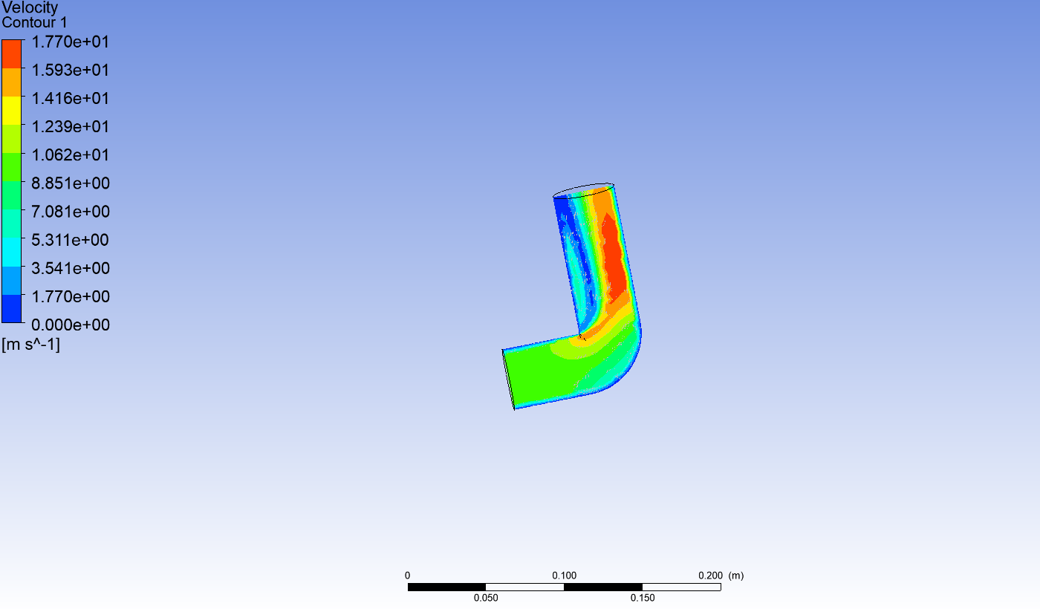
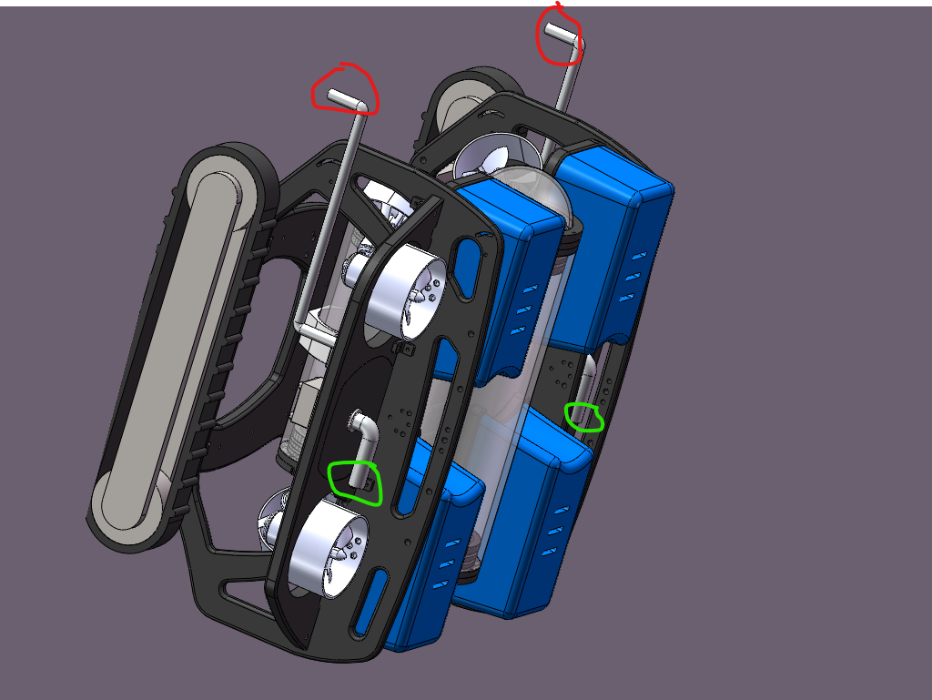
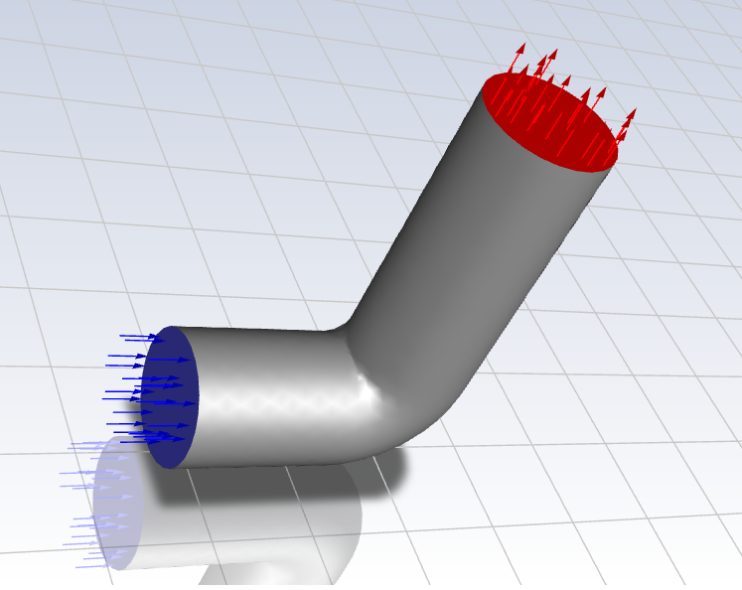
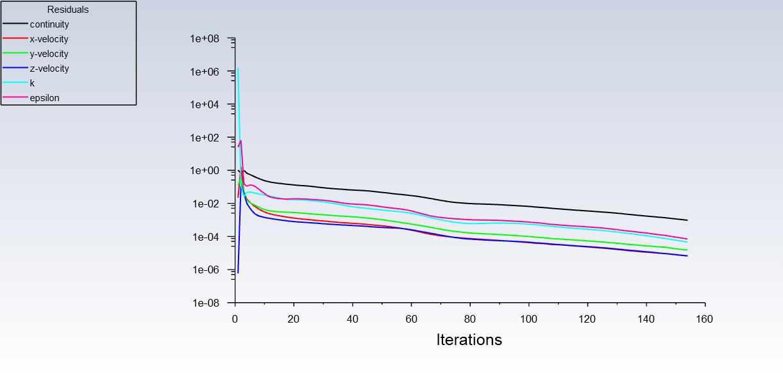
Ship Hull Rinsing Water Squirt Pipe Inlet and Outlet Velocity Analysis
Boyuan Zhao, Dong Zheng
China Coal Technology & Engineering Group Shanghai Co., Ltd.
In recent years, the ship transportation has become more popular with higher transportation rate in the domestic and international businesses. However, due to the fact that ship undertakes the high capacity of the shipment and the travel distance of the ship will rapidly increase in these years; then the ship hull structure will attach plenty of sea creatures and trashes on its lower hull body and it will cause the hull structure chemical corrosion and physical damages.
In order to solve this issue, marine robot associates with its water squirt pipe can deal with this type of issue that can rinse and clean the ship hull so that it keeps the ship structure clean to avoid any chemical corrosions and physical damages on its structure. This paper will use ANSYS software to perform the computational fluid dynamic (CFD) for the water fluent inside the pipe to analyze which velocity is the best range to rinse the ship hull under the water without damage the hull structure.
Introduction
As the iterations of the experiment increases, the water flow velocity will gradually decrease in all three directions. In addition, as illustrated in the graph, the continuity of the velocity is also decrease when more experiments have performed. The major cause of the velocity decreases is the resistance of the tube inner surface. Refer to the principle of the fluid dynamic, the maximum viscosity value exists on the surface of the pipe, which will cause more resistance for water during the travel; simultaneously, the water will possess the maximum velocity at the center of the pipe since it has the lowest resistance. The value of the water flow velocity is not only affected by the factor of viscosity and the inner resistance of the pipe, but it will also be affected in different locations of the pipe. Usually, during the hull rinsing process, the water flow out will have higher velocity compare with the water flow from the inlet.
Structure of the marine robot
As shown in the Figure, the marine robot consists of two pipes with its caterpillar band will attach on the hull body, the inlet is circled in green and the outlet is circled in red. During the hull rinsing procedure, the robot will stick firmly on the inclined hull body, and then it will translate and rotate on the hull surface. The robot contains a high-definition underwater camera with infrared ray detector to recognize any sea creatures or other sea waste attached on the hull body, and then the upper pipe inlet will connect with the water hose on the ground to supply the hydrodynamics thrust inside the pipe, then the water will travel through the pipe; when the water is approaching the outlet, the velocity will grow rapidly to create a high velocity of water squirt so that it can clean the hull effectively.
.
From the information above figure , the water flow velocity remains constant inside the pipe during the water flow. However, when the water is approaching the outlet, the velocity is increasing instantly during the flow. According to the figure 4 scale, the velocity changes from 10 m/s to 17.7 m/s; since during the water flow process, it is required higher pressure that can be provided during the hull rinsing. In addition, the water pipe inside will have the pumping device that can increase the pressure and then boost the velocity at the outlet to flow out.
Existing Problems
1.the water pipe material can be a significant factor that will affect the water transportation rate inside the pipe. As mentioned above, the viscosity of the water will increase at the surface of the pipe, especially if the material is steel. Currently, the pipe material is mainly based on the steel, and the steel has the limitation that it can corrode rapidly while expose to large amount of water, if the inner surface of the steel pipe become rust, then the viscosity will increase to create more resistance for the pipe and it will decrease the water flow velocity.
2.the underwater pressure is another factor need to be considered. When the water squirt out under the sea, the sea water will provide additional resistance that can reduce the speed of the water, as a result, the minimum speed of the water flow is not sufficient to rinse the hull debris away.
ANSYS Fluent flow FEA
It is important to create and develop a ANSYS fluent flow FEA mode to analyze the CFD flow while water flow inside the pipe. In the right figure, it clearly illustrated the water flow direction at the outlet. When the ship hull rinsing process begins, the pipe will absorb the water at the inlet as explained in figure 1; then inside the tube, the water will gradually increase its flow velocity until it reaches the outlet. During the water flow inside the pipe, there will be some resistance or frictions can affect the velocity of the water,
Conclusions
The application of the ship hull rinse is still popular among the marine transportation sector. As the demand of the ship transportation increases, the hull body will undergo more sea creature attach on the surface of the hull that will affect the ship working conditions. This paper explains the water flow velocity that will provide enough kinetic energy to rinse the debris away. However, there are still some restrictions for the pipe material and the sea water resistance can affect the rinse efficiency. Therefore, it is necessary to apply the waterproof material in order to avoid the water corrosion; secondly, it is also crucial to reduce the sea water resistance at the pipe outlet to provide a high velocity during the rinsing.
Bibliography
As shown in the right figure, it takes 160 iterations of the water flow inside the tube to observe the velocity changes in x, y and z directions to obtain the velocity result under the CFD condition. In this particular type of experiment, let the surrounding pressure set to 1 bar, and let the temperature equal to 20°C, the initial velocity of the water flow into the pipe set to 10 m/s.
[1] Mustafa Atmaca, Berkay Çetin, Cüneyt Ezgi, Ergin Kosa; CFD analysis of jet flows ejected from different nozzles; International Journal of Low-Carbon Technologies; Volume 16, Issue 3, September 2021; Pages 940–945
[2] Razali Abidin, Mohamad Asmidzam Ahamat; Design and Simulation of Nozzle for Pure Water
Jet Portable Cutting Tool; International Journal of Innovative Technology and Exploring Engineering; Volume-8 Issue-12S2, October 2019; Pages 703–706
[3] Zhuo Fu, Kun Li; Study on Water Jet Characteristics of Square Nozzle Based on CFD and Particle Image Velocimetry; Mechanical Properties of Materials and Symmetry/Asymmetry; 2022, 14(11), 2392
[4] Oleg Urazmetov, Marcel Cadet; Investigation of the flow phenomena in high-pressure water jet nozzles; Chemical Engineering Research and Design; Volume 165, January 2021; Pages 320-332
[5] Nilesh Kumar Sharma, Satish Kumar Dewangan; CFD analysis of turbulent free high-speed water jet issuing from circular and non-circular nozzle geometry in context of abrasive slurry jet machining; International Journal on Interactive Design and Manufacturing (IJIDeM); Volume 18, (2024); Pages 2393–2403
Order online at https://www.postersession.com/order/

