Slide 1
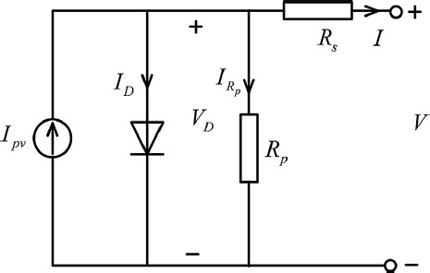
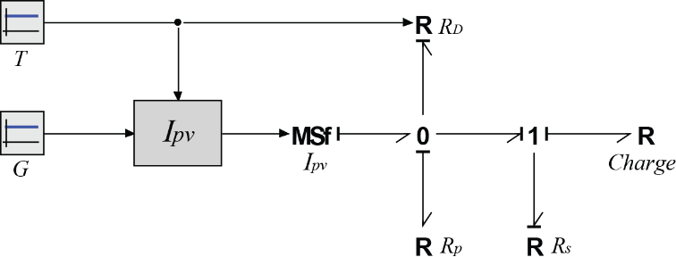
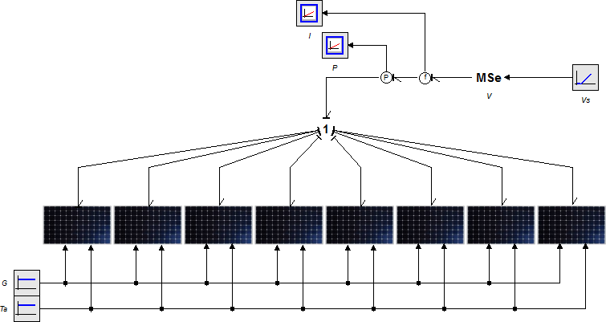
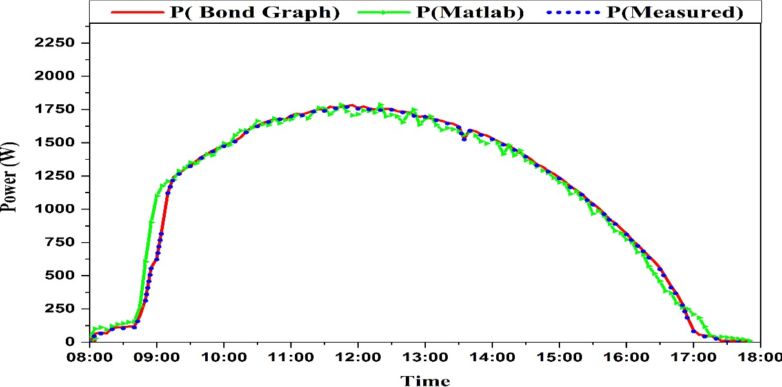
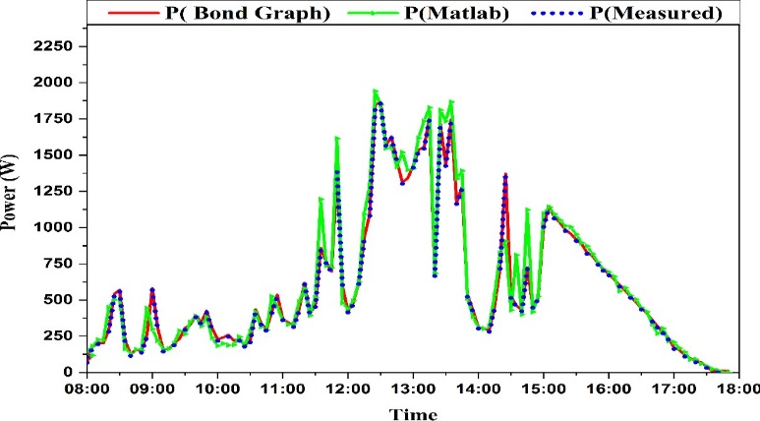
Paper ID:
2024 International Conference on Applied Mathematics, Modeling and Computer Simulation (AMMCS 2024)
Optimization of Photovoltaic System Modeling: A Comparative Study and Experimental Validation Using Bond Graph Methodology and a Genetic Algorithm
Mustapha ADARª*, Mohammed-Amine Babayª, Mourad Boussifª, Zakaria Khaouchª, Zakarya Abbassi^{b}, Youssef Najihª and Mustapha Mabroukiª
ªIndustrial Engineering Laboratory, Sultan Moulay Slimane University, Morocco
bLaboratory of Search in Physics and Science for Engineer, Sultan Moulay Slimane University, Morocco
*Corresponding author's email: adar.mustapha@gmail.com
Introduction
The rapid growth of urbanization and industrialization has dramatically increased energy demand worldwide, leading to a reliance on fossil fuels, which exacerbates environmental pollution and energy crises. As a result, integrating green and low-carbon energy sources into traditional power systems has become essential. Among renewable resources, solar energy stands out for its safety and environmental benefits, driving significant growth in photovoltaic (PV) systems. Accurately modelling PV systems and identifying parameters is crucial for predicting power output and enhancing MPPT tracking [1]. Circuit-based single-diode and double-diode models are commonly used to replicate PV performance, with newer multidimensional diode models allowing for technology-specific customization[2] . Various methods have been developed to identify PV model parameters, including improved algorithms such as the ant lion optimizer (IALO) [5], enhanced particle swarm algorithms [4], and the teaching-learning-based optimization (STLBO) method, which incorporates local search strategies for greater accuracy [6]. Additionally, the month flame optimizer (MFO) has been refined to estimate PV parameters using the three-diode model [7].
Research objectives
Presentation of a methodology designed to model a solar photovoltaic plant.
Modelling and simulation of PV system using Bond Graph approach, Genetic Algorithms and Matlab.
Methods
The bond graph model of the PV system, directly derived from the equivalent electrical circuit, is illustrated in Figure 2. To represent the Ipv, we employ a modulated MSf since the Ipv is contingent on both solar irradiance G and cell temperature T. It is mathematically expressed as follows in Eq. (1)
PV Cell model
The commonly used one-diode model, shown in Figure 1, represents the electrical characteristics of a PV cell. In this model, a current generator (Ipv), influenced by solar radiation (G) and cell temperature (T), operates in parallel with a diode that converts solar radiation into electricity. Additionally, series resistance (Rs) accounts for resistive losses, while shunt resistance (Rp) models cell leakage
Figure 1. Equivalent electrical circuit of the PV cell
Numerical simulation
In the provided equation, Ipv,ref represents the photocurrent, Gref denotes the solar irradiance, and Tref signifies the cell temperature under standard reference conditions. Additionally, α'T represents the relative temperature coefficient of the short-circuit current. At times, companies can determine the absolute temperature coefficient of the short-circuit current, denoted as αT, specific to a certain solar panel.
The photovoltaic panel model is formulated by arranging photovoltaic cells in either series, which serves to augment the panel's voltage in parallel, which enhances its current, or through a combination of both series and parallel configurations, as stipulated by mathematical expressions .
Figure 2. PV cell Bond Graph model
Figure 3 PV plant Bond Graph model.
Results
The results show that the power values calculated using the bond graph model closely match the instantaneous power measurements taken on two days. When comparing the simulated data with experimental results, the root mean square deviation was used. On a sunny day, the bond graph model had a percentage error of 3.2%, compared to 6.3% for the Simulink model. On cloudy days, the deviations were more pronounced, with the bond graph model showing a maximum difference of 6.4% and the Simulink model 14%.
we conducted a validation process using experimental data from the photovoltaic plant and the Simulink MATLAB program. We selected two representative days to conduct this validation: a sunny day and a fully cloudy day. Figures 4 and 5 provide the power curves, both measured and simulated, for the mc-si PV modules.
Figure 4. Comparison between predicted and measured powers for the sunny day
Figure 5. Comparison between predicted and measured powers for the cloudy day
Conclusions
The study applied the bond graph technique to model two photovoltaic systems using real-world temperature data for greater accuracy.
A genetic algorithm was used to determine five unknown parameters of the photovoltaic cell.
Comprehensive validation through comparative analysis with actual data confirmed the model's reliability and effectiveness.
References
[1] D.S. Pillai, B. Sahoo, J.P. Ram, A. Laudani, N. Rajasekar, N. Sudhakar, Energy Procedia 117 (2017) 1054–1061.
[2] A. Massi Pavan, S. Vergura, A. Mellit, V. Lughi, Sol. Energy 155 (2017) 647–653.
[3] A. Fajardo Jaimes, F. Rangel de Sousa, Sol. Energy 157 (2017) 792–802.
[4] Z. Wu, D. Yu, X. Kang, Energy Convers. Manag. 151 (2017) 107–115.
[5] Z.Q. Wu, Z.K. Xie, C.Y. Liu, Trans. Inst. Meas. Control 42 (2020) 1191–1203.
[6] K. Yu, J.J. Liang, B.Y. Qu, X. Chen, H. Wang, Energy Convers. Manag. 150 (2017) 742–753.
[7] D. Allam, D.A. Yousri, M.B. Eteiba, Energy Convers. Manag. 123 (2016) 535–548.

