Slide 1


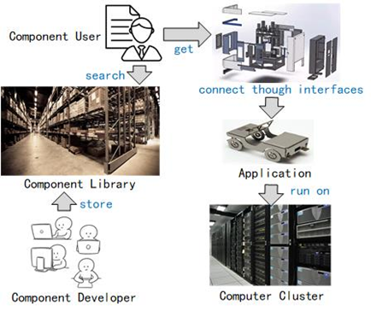
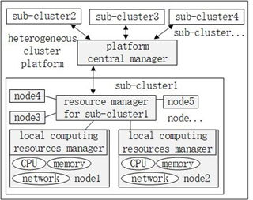
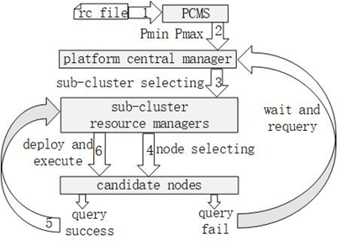
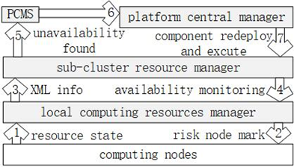
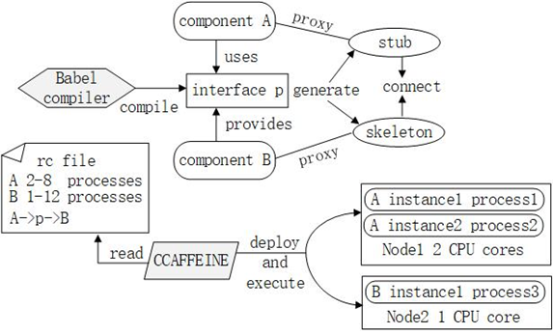
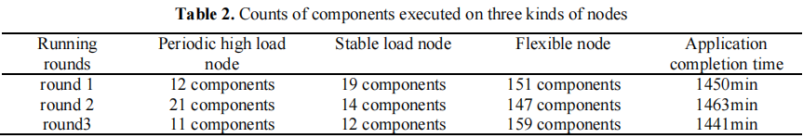
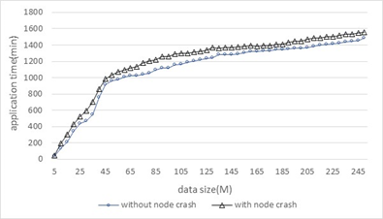
Safe Execution of Parallel Component Applications on an Unstable Heterogeneous Cluster Platform
Yunfeng PENG, Congming SHI, Guowei GAO, Jianan WANG, Hai LIU
Introduction
Methods
Parallel software to solve scientific problems such as molecular dynamics simulation tend to be deployed on a self-built cluster composed of heterogeneous servers for economic considerations. The performance of a heterogeneous cluster is often extremely unstable.
Hierarchical management of computing resources
Optimal deployment of parallel components
Results
Experimental results show that the proposed method can deploy parallel components optimally, and it can deal with the problem of node failure on unstable heterogeneous clusters well. The cost of component task transfer and restart is very small.
Method dealing with node failure
components connection and running mechanism
When the parallel component is running, if the monitored burden of a computing node is heavy, it will be marked as a risk node. By finding the unavailable risk nodes in time, and regenerating and running the component tasks on other nodes with light load, the adverse impact of computing resource failure on the component execution is reduced.

