Slide 1
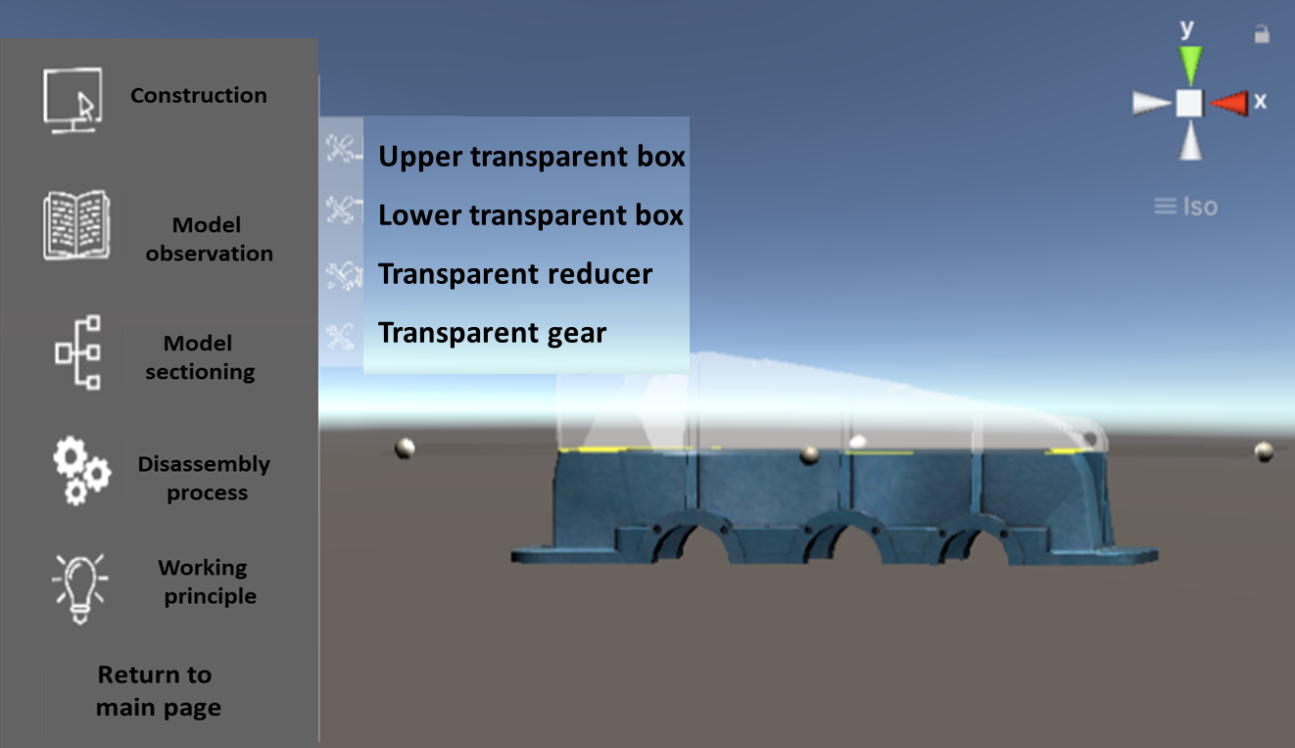
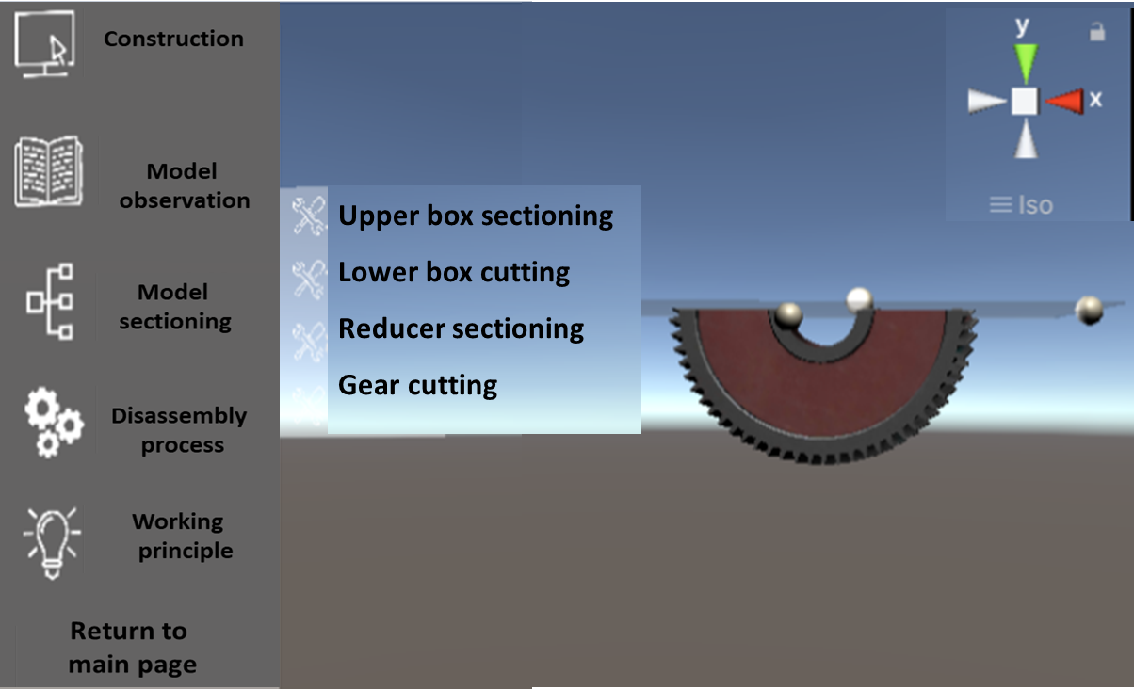
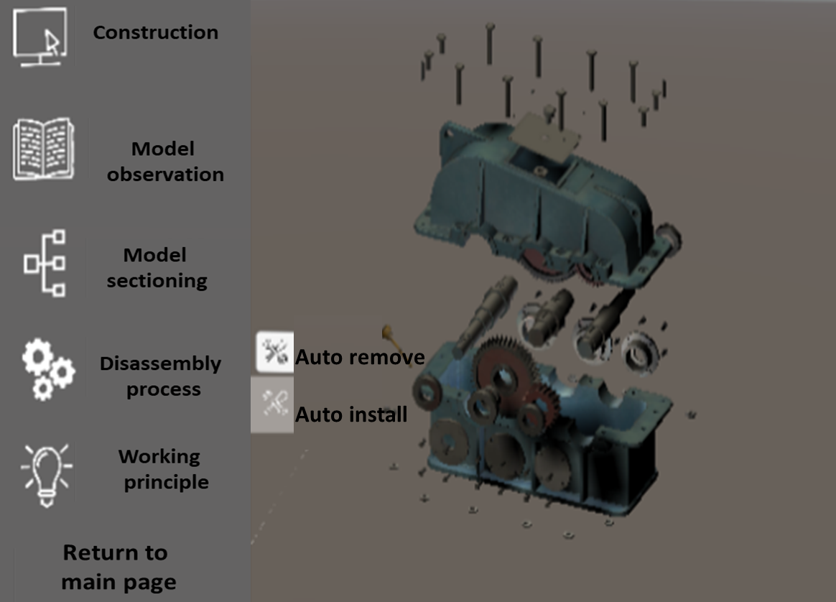
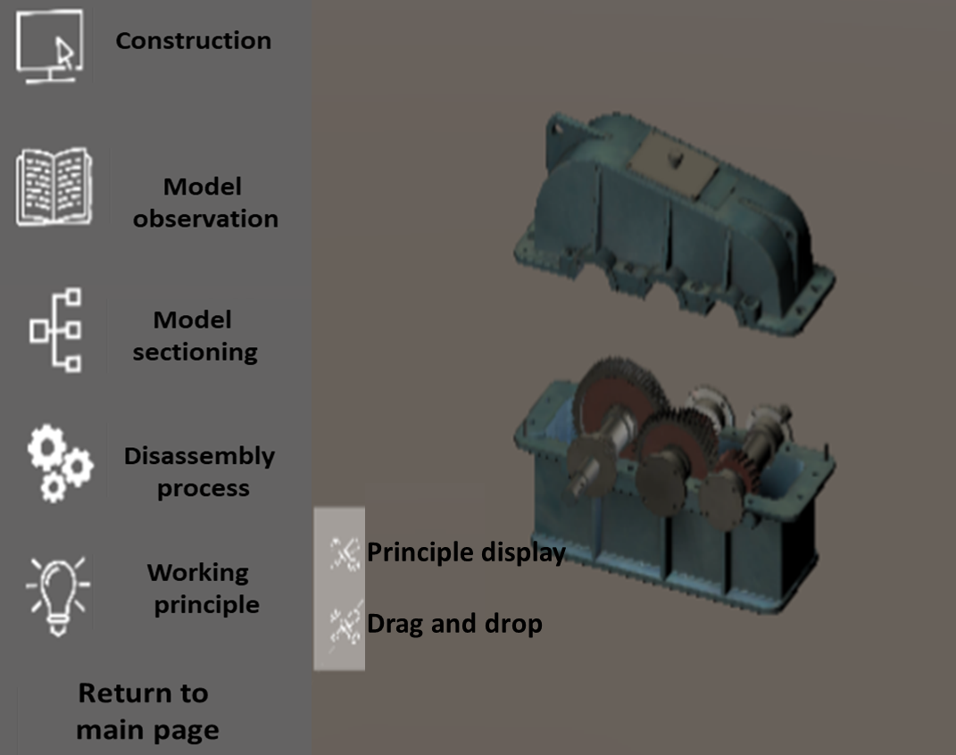
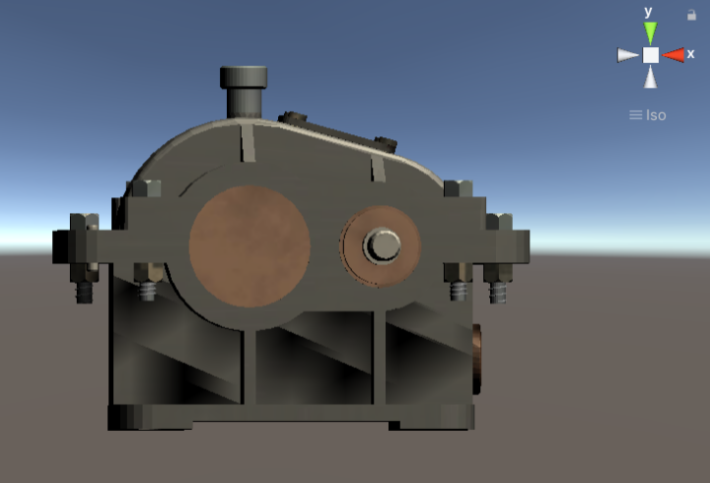
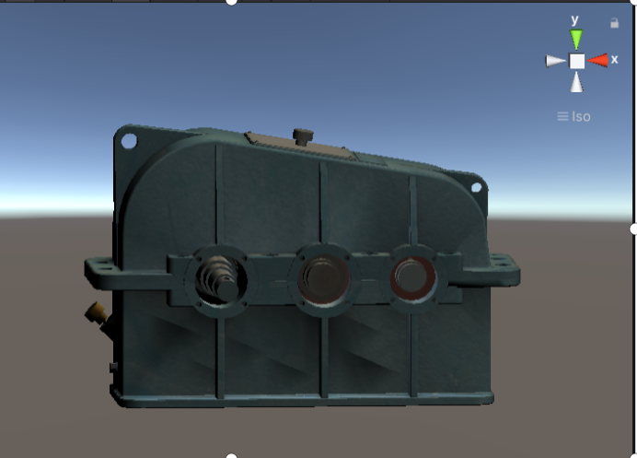
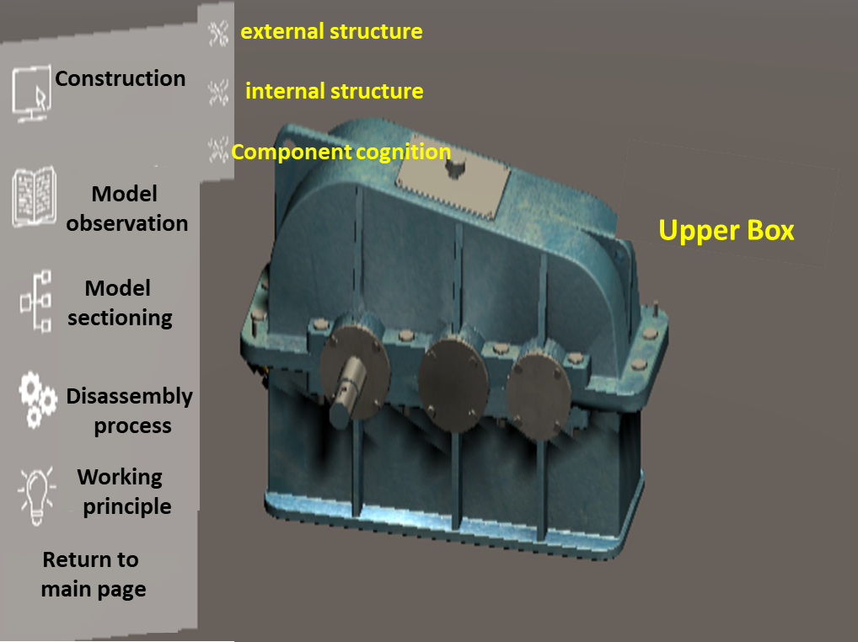
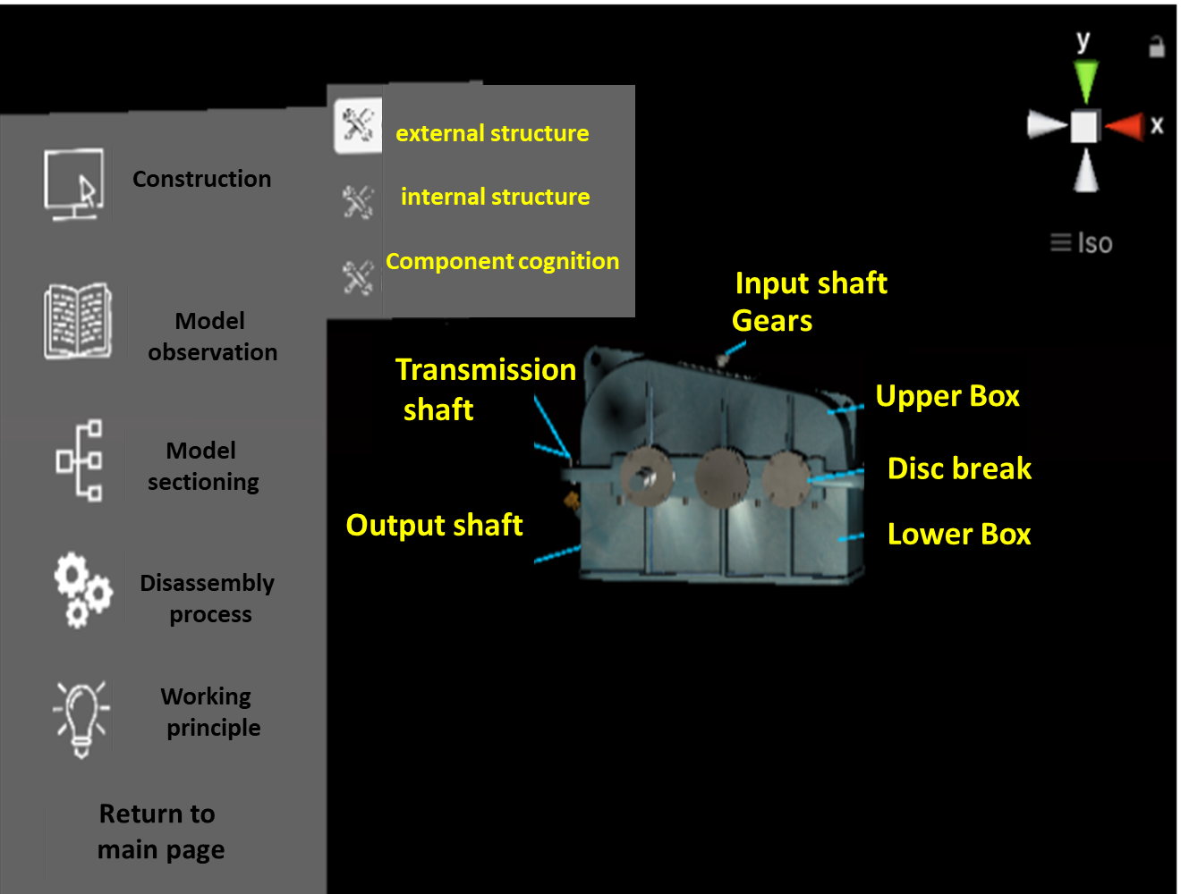
Research and Development of Reducer Virtual Simulation System based on Mixed Reality (MR) Technology
AMMCS2024
Affiliation’s Logo
Goes here if any
Liang Feng, Liu Junying
College of Mechanical and Electrical Engineering, Heyuan Polytechnic,
Introduction
In order to improve learning pleasure and save teaching costs, this paper uses MR technology to research and develop the virtual simulation system of reducer.Take the primary reducer and the secondary reducer as the development prototype of the simulation system, use 3ds-max software to create and render the model at 1:1 scale, use Photoshop software to edit the reducer map and other effects, select Unity 3D software as the mixed reality development platform, and use C # language programming to realize the animation and interactive functions of the simulation system. The reducer virtual simulation system developed in this paper has five modules and functions: structure introduction, model observation, model sectioning, disassembly and assembly process, and working principle. The application of this system can improve students' learning pleasure and practical ability, and save the teaching cost waste caused by purchasing multiple reducers.
Methods
The overall development idea of system is to use 3DMAX software to model and render the 3D model of each part and composition of the reducer, use Photoshop software to map and effect processing the model. Then, import the model into the Unity 3D platform for MR scene construction, build UI buttons and other functions for display, and use C# language as animation script development software for interactive demonstration and animation production.
Conclusions
This paper selects Unity 3D as the mixed reality development platform, employs C# language programming to realize the animation and interactive functions of the simulation system, and uses the primary reducer and secondary reducer as the simulation system to develop the prototype. The five modules and functions of the created virtual simulation system for reducers are structure introduction, model observation, model sectioning, disassembly process, and operating principle. The system, which is based on MR technology, shows the reduction in mixed reality, integrates mixed reality technology with structural cognition, allows users to disassemble and reassemble the reducer, evaluates its operation, and creates a bridge between theory and reality for users.
Graphics / Images

