Slide 1
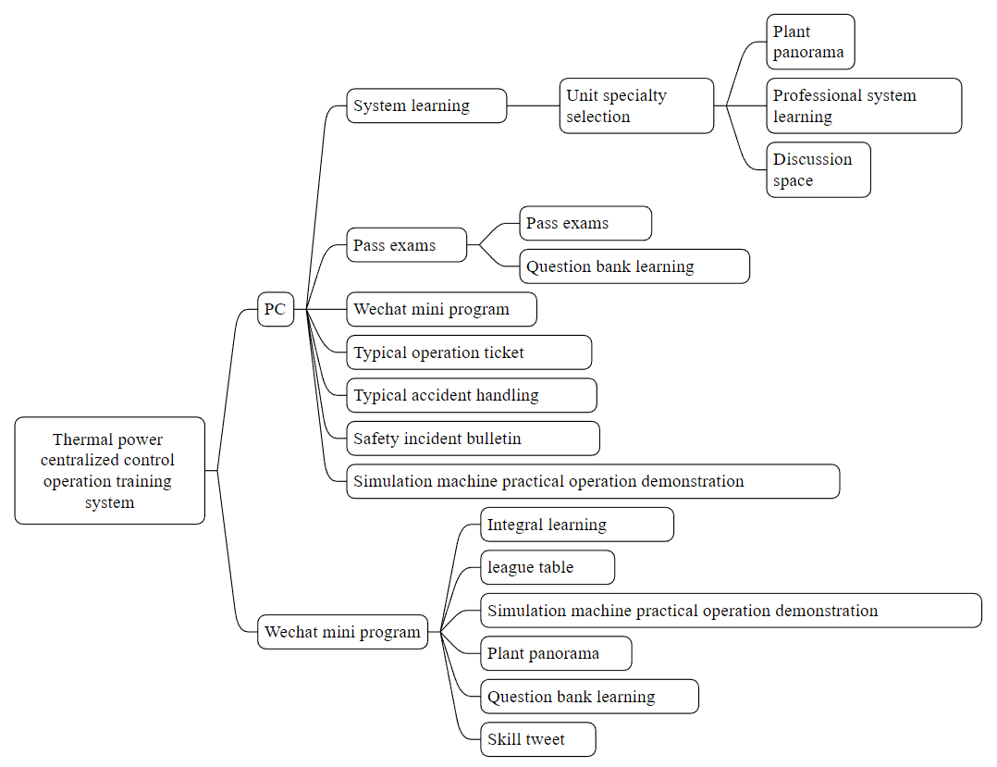
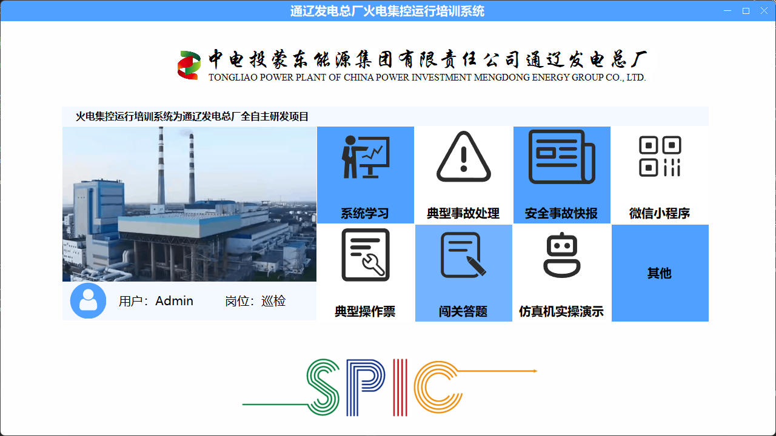
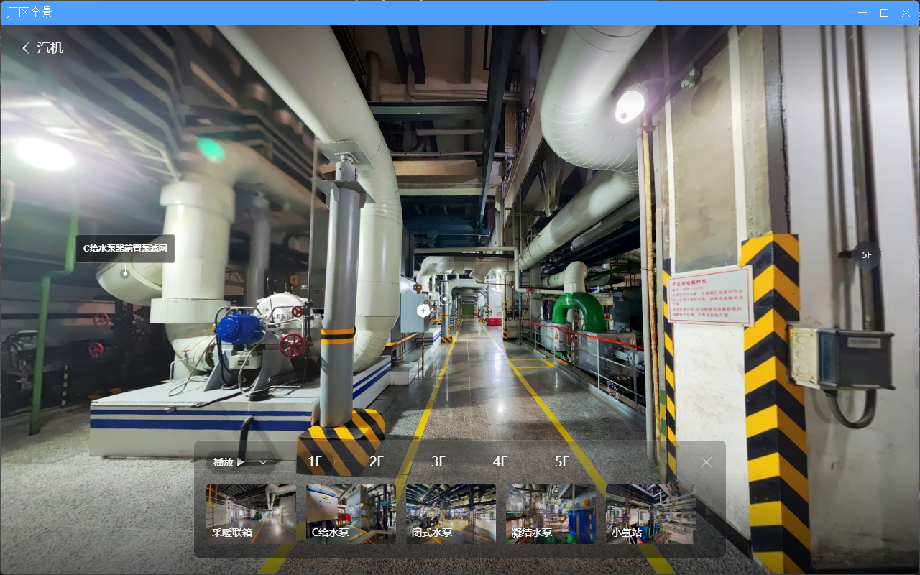
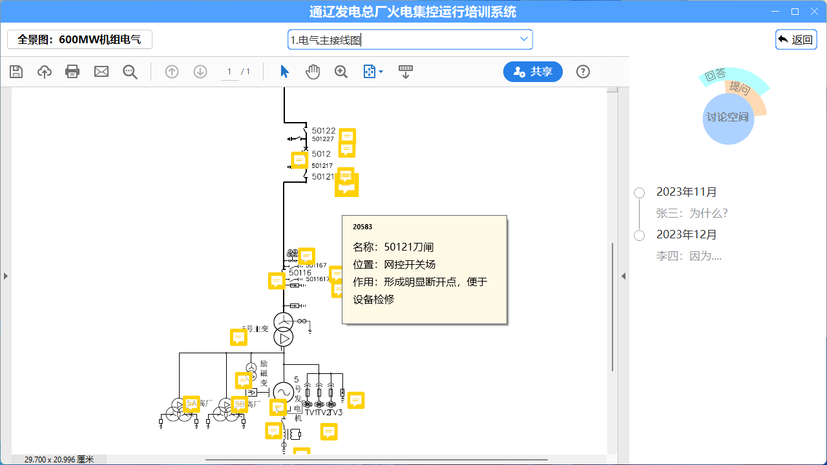
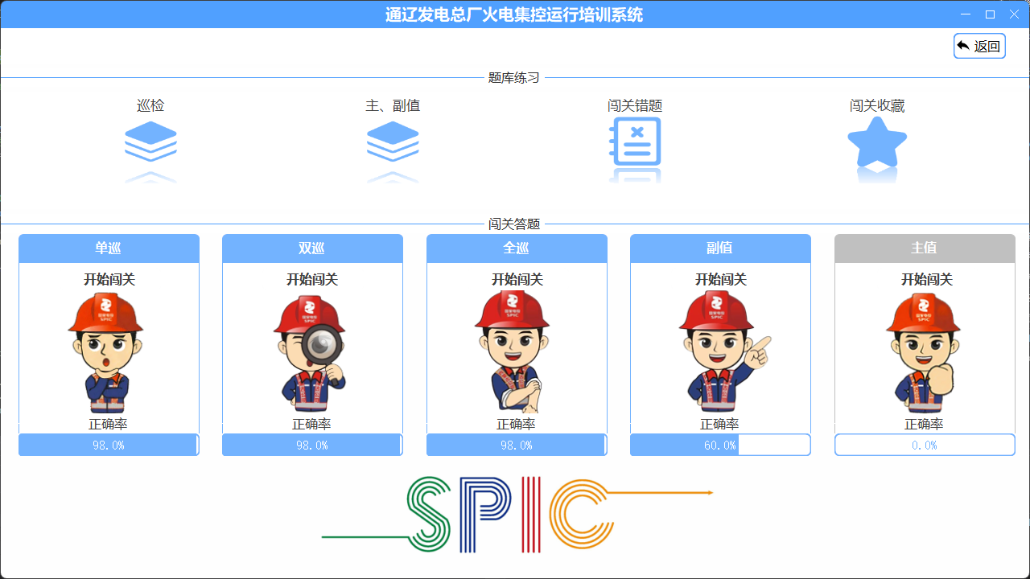
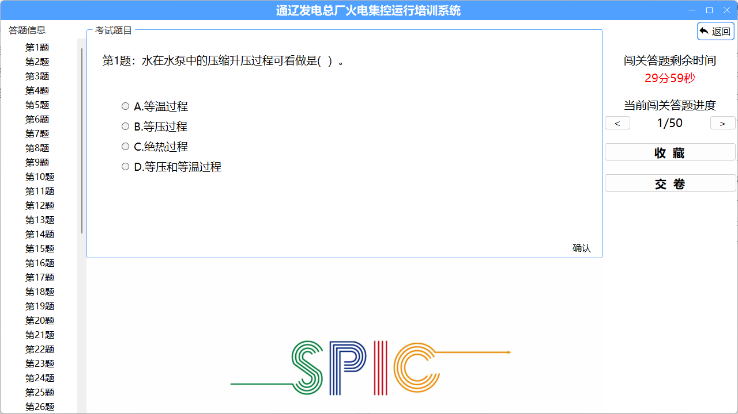
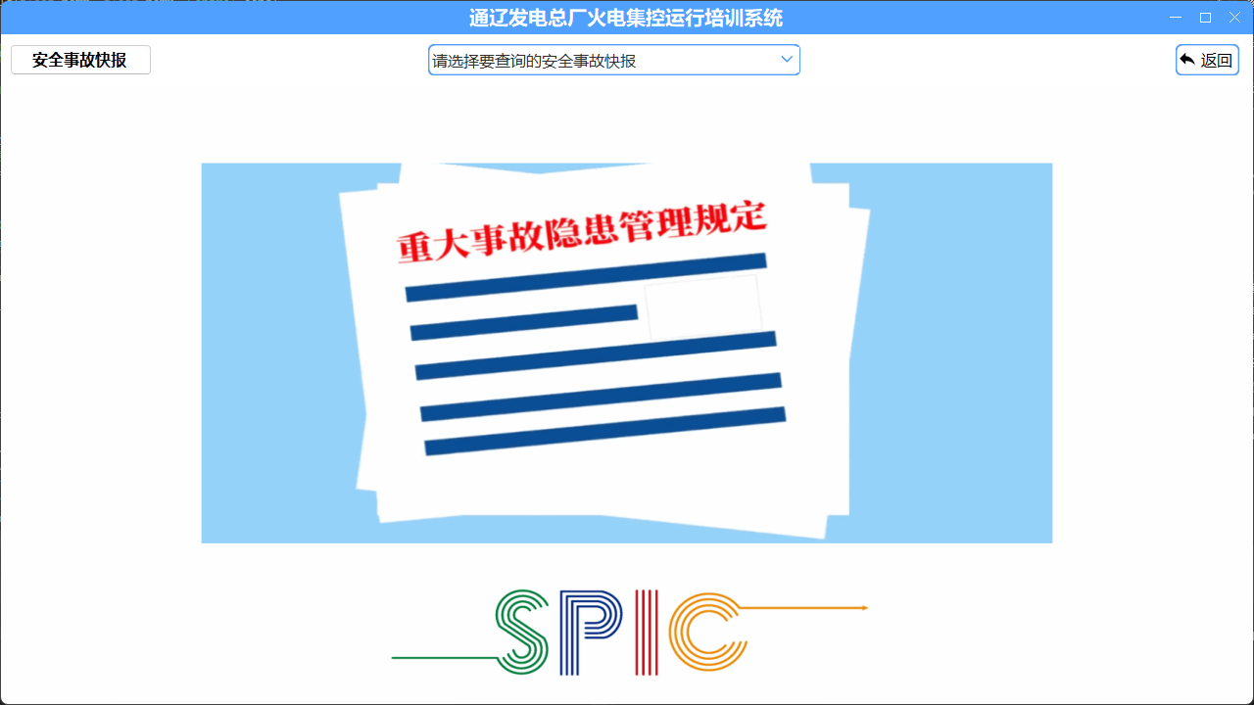
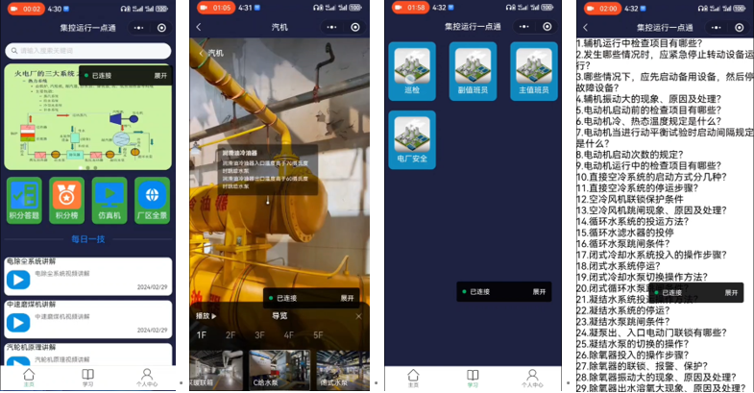
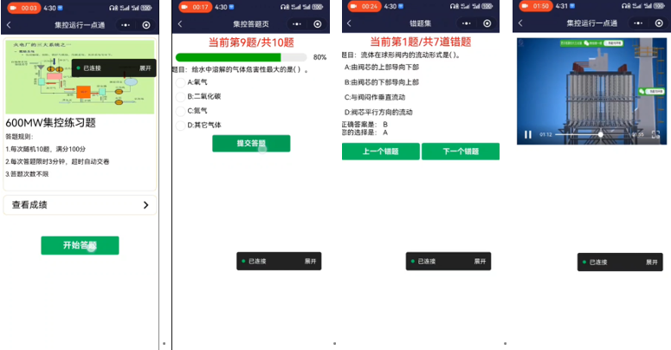
CS785
Research and application of thermal power centralized control operation training system
Zhaolei Lianshan Wangyong
(CPI MENGDONG ENERGY GROUP CO,LTD.TONGLIAO GENERAL POWER PLANT, Tongliao, Inner Mongolia 028011)
Introduction
Thermal power enterprises are an important part of the energy industry and a crucial guarantee for national energy security. The operation of thermal power enterprises directly affects the stability and development of the national economy. Having a high-quality workforce with excellent job skills is key to the healthy and stable development of thermal power enterprises. Research has found that the training methods for thermal power plant control operations lack liveliness and vividness, significantly impacting the learning efficiency and experience of employees, which is a major pain point in the training of most thermal power enterprise employees today. Furthermore, as thermal power enterprises serve as a critical safeguard for national energy security, they recruit a large number of new employees every year, indicating that the training of thermal power plant control operation staff is a recurring issue. Therefore, making professional training more lively and vivid, enhancing the learning motivation of new employees, and accelerating the pace of mastering the necessary system learning for thermal power units are of significant importance for the healthy and stable development of thermal power enterprises.
System design ideas
The thermal generator set system is mainly composed of three major sections: steam engine, boiler and electric. The number of on-site equipment in the three major sections of the unit is large, the structure is complex, and the on-site equipment layout between the units is different, and the existing system diagram and procedures are relatively discrete teaching materials, and the system diagram is not effectively combined with the actual situation on the site, which slows down the rhythm of system learning and mastering for new employees. To solve this problem, based on the existing system diagram and procedures, this paper collects the information of the three major on-site equipment of steam engine, boiler and electricity of the enterprise thermal generator set, and integrates a number of learning contents such as the learning question bank of the operation duty officer, typical operation ticket, typical accident handling, safety accident bulletin, and practical operation demonstration of the simulation machine into a visual display. The specific system flow is shown in Figure 1.
Figure 1. System flow chart
PC software design
Through the main form module, users can conveniently browse and select the required learning content for learning and operation, as shown in Figure 2.
Users can query and learn the name, model specifications, daily maintenance points, operating procedures, equipment principles and so on by clicking these labels, as shown in Figure 3.
The user clicks the system learning module and selects the major of the unit to be learned, the system interface will switch to the system content selection interface as shown in Figure 4.
As shown in Figure 5, according to the operating post system, five checkpoints including single inspector, double inspector, full inspector, secondary watch officer and main watch officer are designed.
After the user learns the relevant professional question bank of the relevant unit, he can play the fun game through the clearance answer module to test and evaluate the self-learning situation, as shown in Figure 6.
In the training system, in addition to the main systematic learning and passing questions, a number of auxiliary function modules are also designed as shown in Figure 7, such as typical operation tickets, typical accident handling, safety accident report and simulation machine practical operation demonstration, etc.
Figure 2. Training system main form
Figure 3. Plant panorama
Figure 4. Professional systematic learning
Figure 5. Pass answering checkpoint
Figure 6. Pass exams
Figure 7. Sub-function module
Mobile terminal software design
As shown in Figure 9, functions such as PC simulator practical operation demonstration, factory panorama and question bank learning are also continued in the wechat mini program.
As shown in Figure 10, the integral answer function is a highlight of wechat mini program. The system pushes 10 questions to the user every day, and the user can answer them anytime and anywhere, and it takes a very short time to complete. The system will also record the user's answer points, and rank according to the points, set up reward and punishment rules, encourage users to participate actively, and improve the learning enthusiasm and happiness index of employees. Daily technology push is another feature of wechat mini program, the system pushes a technical knowledge or operation skills every day, to help users continue to learn and improve skills.
Figure 9. Same function with PC
Figure 10. Points answer and a daily push
Conclusions
This paper deeply studied the pain points of production line, grasped the pain points of traditional thermal power centralized control operation training mode under the condition of zero capital investment, innovatively applied modern technology, and independently developed the training system on PC and mobile. The multi-end training system provides a variety of learning methods and personalized learning experience, including factory panorama, pass answer, daily push and other personalized functions, to provide users with a rich, convenient and personalized learning experience, so as to promote the learning enthusiasm and happiness of employees. In addition, after the pilot application and feedback collection of the training system, it is found that the effect of the system is significant, not only the learning efficiency of employees, learning experience has been improved, but also effectively reduce the cost of new staff training, reduce the equipment loss rate, failure rate, and improve labor productivity. The success of the pilot application has also promoted the promotion of the training system to other professional sectors such as maintenance, safety and environmental protection and related departments to meet a wider range of training needs.

