Slide 1

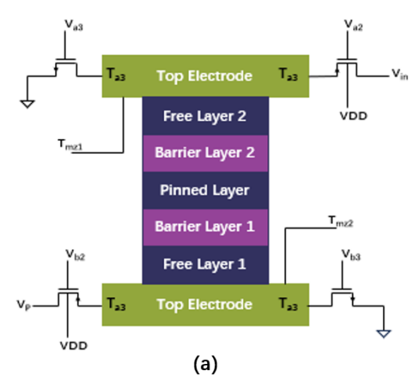
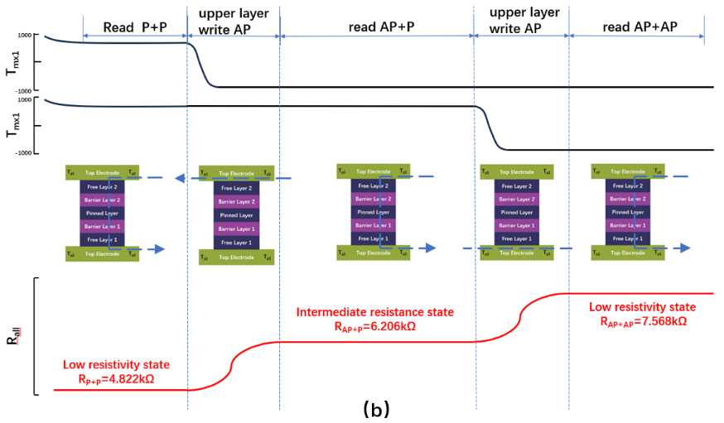
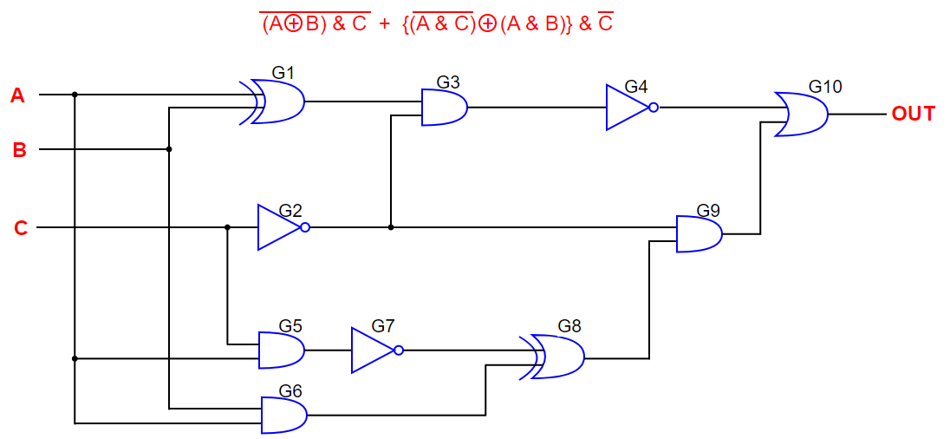
Boolean Logic Operations based on Four-terminal Magnetic Tunnel Junction for Computing in Memory
AMMCS2024
Hui Jin, Sijia Liu, Xiaoyang Xu, Siyu Chen, Jiaqing Li, Zhaohao Wang,Youguang Zhang, Bi Wang
School ofElectronics and Information Engineering & School ofIntegrated Circuit Scienceand Engineering,Beihang University, Beijing 100l9l, China
Beijing Institute ofRemote Sensing Equipment, 100089,China
Introduction
The device structure proposed in this paper has three different stable resistance states, greatly enhancing the flexibility in designing logic gates. By defining different sense amplifier reference resistances and corresponding logic states for the multi-resistance, complete logic operations can be achieved, including AND, OR, NOT, NAND, NOR, XOR, and XNOR. For example, when implementing an AND gate, the reference resistance can be defined as REF_and, and when the actual resistance is greater than this reference resistance, the device is in logic state 1.
The Von Neumann architecture urgently needs to overcome the bottleneck of the storage wall issue, which can be effectively addressed by the emerging Magnetic Random Access Memory (MRAM) due to its high speed, non-volatility, low power consumption, high integration, durability, and compatibility with CMOS. This makes magnetic storage an optimal solution for overcoming the bottleneck of the Von Neumann architecture. However, pure magnetic storage devices for storage and computation are not yet available. Therefore, the optimization of novel MRAM structures has become a new choice for future computing in memory. This paper proposes a four-terminal magnetic tunnel junction (MTJ) device structure basic principle of Spin-Orbit Torque (SOT) , which has muti-bit and capable of performing logical operations such as AND, OR, and XOR with ultra-high computational efficiency. The proposed device structure is verified to perform Boolean logic operations in one cycle by Cadence simulation, which providing a new method for in-memory computing in our solution
Graphics / Images
Methods
PL | I1 | I2 | FL1 | FL2 | STATE | AND | NAND | OR | NOR | NOT | XOR | XNOR
→ | → | → | → | → | P | 0 | 1 | 0 | 1 | 1 | 0 | 1
→ | → | ← | → | ← | HP | 0 | 1 | 1 | 0 | * | 1 | 0
→ | ← | → | ← | → | HP | 0 | 1 | 1 | 0 | * | 1 | 0
→ | ← | ← | ← | ← | AP | 1 | 0 | 1 | 0 | 0 | 0 | 1
The magnetization directions of FL1 and FL2 are controlled by the direction of the write current from the bottom and top electrodes, respectively. For each side of the MTJ device, when the free layer is in a parallel alignment with the fixed layer, the device is in a low-resistance state; when the free layer is in an antiparallel alignment with the fixed layer, the device is in a high-resistance state.
The two stable resistance states commonly found in MTJ structures, namely the low-resistance state and high-resistance state, have been widely proven and applied. In order to demonstrate that the proposed structure can achieve stable states beyond the low-resistance and high-resistance states, we conducted circuit-level simulations, and the results are summarized below.
Tmx in the figure represents a virtual terminal reserved by the Verilog-A model of the device. By measuring the value of Tmx, the device can be determined to be in a high-resistance state or a low-resistance state. When Tmx=1, the free layer is in parallel alignment with the reference layer, indicating that the device is in a low-resistance state; when Tmx=-1, the free layer is in an antiparallel state with the reference layer, indicating that the device is in a high-resistance state. Rall represents the overall resistance value of the device. Analysis of the simulation waveforms reveals that the resistance value is 4.822kΩ when the device is in the low-resistance state, 6.206kΩ when in the intermediate state, and 7.5683kΩ when in the high-resistance state.
The Tunnel Magnetoresistance Ratio (TMR) between the two resistance states is defined as TMR=(R2-R1)/R1, where R1 and R2 correspond to the two different resistance states of the device. For the proposed multi-resistance MRAM storage unit structure in this paper, TMR1=28.70% for the intermediate state and low-resistance state, and TMR2=21.95% for the high-resistance state and intermediate state.
Conclusions
This paper presents a multi-bit storage and computing device based on a four-terminal SOT-MTJ, which effectively increases storage density while maintaining the original SOT-MRAM process steps. The four-terminal SOT device enables the completion of 16 kinds of Boolean logic operations in one-step operation, effectively reducing computation time and power consumption, thus achieving true in-memory computing.

