Slide 1
Paper ID: CS748
The 4rd International Conference on Applied Mathematics, Modeling and Computer Simulation (AMMCS 2024)
Distinguishing Interior and Exterior Walls Based on Visuallisp Architectural Vector Graphics and Research on Room Area Identification Algorithms
Rui LUO¹
China Construction Third Engineering Bureau Group Co., LTD, Wuhan, China.
*Corresponding author's email: 395454836@qq.com.

Slide 2
Introduction
When calculating the heating and cooling loads of buildings, the continuous input of dimensional information of building graphics leads to frequent human-computer interactions, significantly reducing design efficiency. If intelligent recognition of building components such as interior and exterior walls, doors, and windows in building drawings can be achieved, load calculations can automatically extract this information, thereby partially realizing the intelligence of HVAC design to a certain extent and greatly improving work efficiency. From the perspectives of heating, gas supply, ventilation, and air conditioning professions, this paper combines computer graphics and artificial intelligence theories to research and develop algorithms for distinguishing interior and exterior walls and identifying room areas in architectural vector graphics.

Slide 3
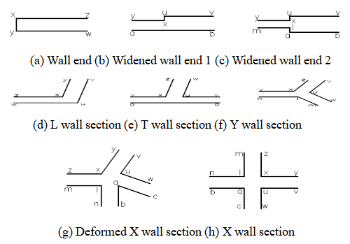
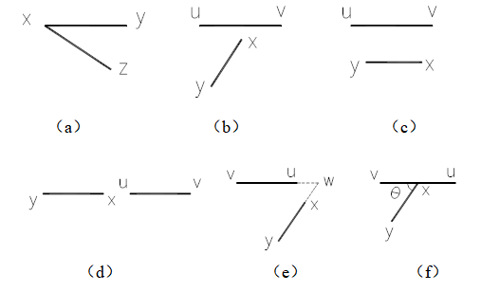
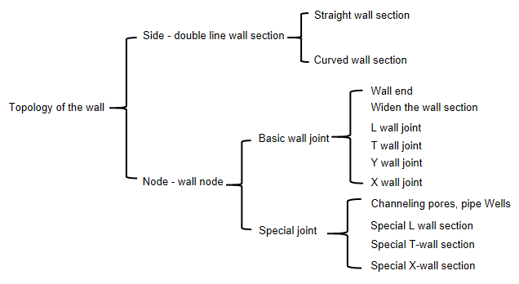
Wall recognition
The wall symbol on the building plan is a closed figure composed of line segments, so it is the most reasonable process to use the closed area extraction method[5] to identify the wall, and then study the recognition algorithm for complex walls based on basic wall recognition. the identification steps are as follows:
Figure 1. Geometric constraints between six types of line segments
Figure 3. Legend of basic wall section
Predicate logic is used to define the expression of basic wall sections, and the inference rules of basic wall sections are derived from the geometric constraint relationships between line segments.
Figure 2. Composition diagram of wall symbol

Slide 4
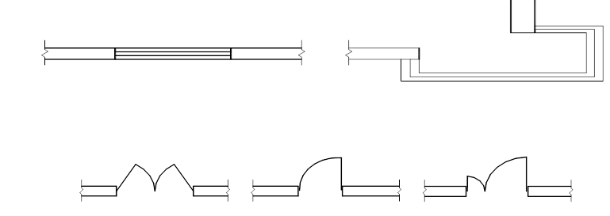
Door and window block analysis algorithm
Every drawing file has an invisible data area called a block definition table. The block definition table stores all block definitions, including all associated information of the block.
Generally, it is the same width as the wall. Then during identification, the topological relationship with the wall and its own geometric characteristics can be used to make a judgment.
The identification steps are as follows:
Extract wall end information.
Use wall end nodes to search for tiles within a selection range.
Obtain the block and analyze the geometric constraints of the internal elements of the block according to the characteristics of the window.
Return the recognition result and store it.
Figure 6. Illustrations of doors and windows

Slide 5
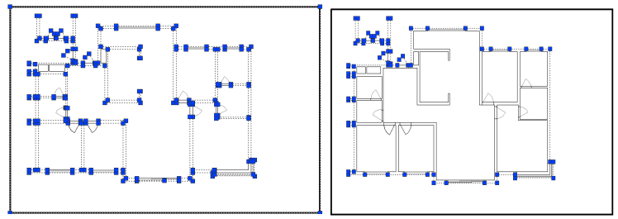
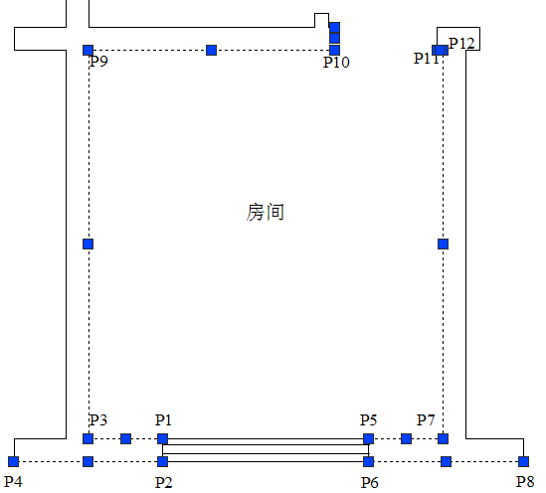
Internal and external wall differentiation algorithm
The distinction between interior and exterior walls has always been a blind spot and difficulty in the field of architectural graphic recognition.
The user selects the frame of the architectural drawing, and combines the frame, connecting line segments and identified walls to form a selection set boundary_ss 1, as shown in Figure 7.
Figure 8. Polyline Figure 9. Contour line
Perform internal and external point search based on nodes on the contour.
Figure 7. Closed construction set
Extract the outline polyline entity, and then operate on the entity to extract the node table.
Figure 10. Inner point and outer point definition legend

Slide 6
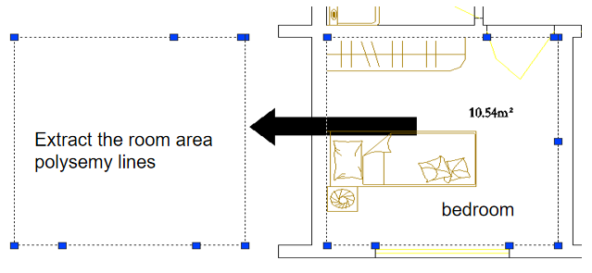
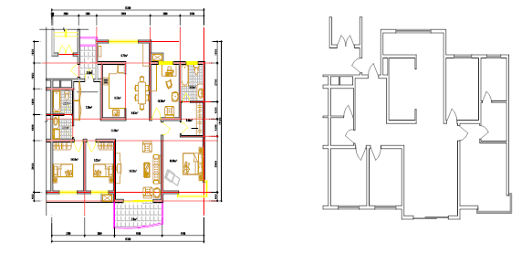
Room area recognition algorithm
A closed area block formed by wall sections connecting each wall segment . A complete wall topology in a building plane is composed of multiple such closed area blocks, which are connected to each other through door and window symbols. up to form a closed room.
Through wall recognition, door and window recognition, and internal and external wall recognition, the recognition information has now been obtained. The following two schematic diagrams are used to illustrate the obtained information.
Obtain the closed area polyline entity generated by the BOUNDARY command, and then operate on the entity to extract the node table. As shown in Figure 13:
Figure 12. Wall recognition example
Figure 13 . Example of room area polyline

Slide 7
Conclusion
This article systematically introduces the recognition algorithm used by the author's architectural vector graphics recognition system RI based on Visual Lisp language.
It provides a more detailed algorithm description for wall recognition, block analysis of doors and windows, internal and external wall recognition, and room area recognition.
The entire recognition process was analyzed in detail, and an algorithm model for room area recognition was established, paving the way for further recognition of complex walls, doors, windows, and rooms.

Slide 8
References
[1] Dong Wenping. A preliminary study on intelligent recognition and understanding of architectural graphics.
[2]Master's thesis, Harbin Institute of Technology.2004:4-25.
[3]Yuan Xiang . Intelligent recognition and understanding of architectural graphics. Master's thesis of Harbin Institute of Technology. 200 5 : 10~18
[4]Jia Zheming, Fu Yonggang, Dai Guozhong . Recognition method of wall symbols in understanding building plans. Computer Engineering and Applications, 2004 , 10 :201
[5]Sun Jiaguang. Computer Graphics. Tsinghua University Press. 1998.9: 413~415

