Slide 1


The 3rd International Conference on Applied Mathematics, Modeling and Computer Simulation (AMMCS 2023)
Role of V-shaped Pits on Hole injection in InGaN MQWs: First-principles calculation
Qingqing Feng
Key Laboratory for Optoelectronics and Communication of Jiangxi province,
Jiangxi Science and Technology Normal University
2023.09.13

Slide 2

Contents
1
Research Background
2
Research Methods
3
Calculation Results
4
Conclusions

Slide 3
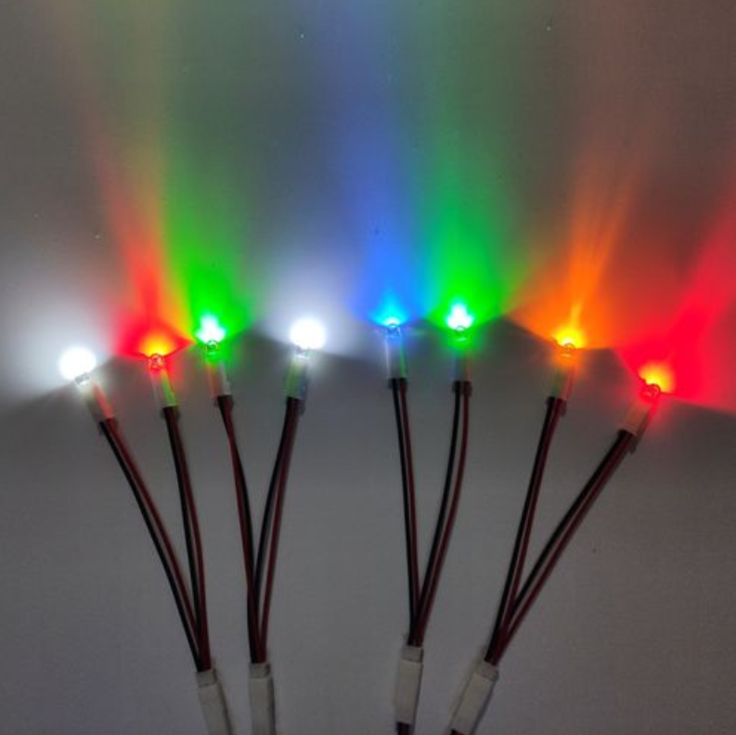
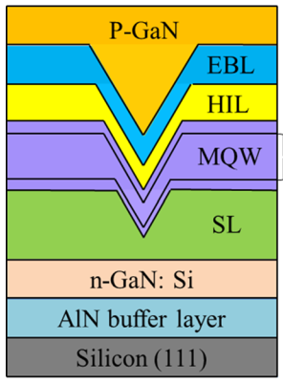
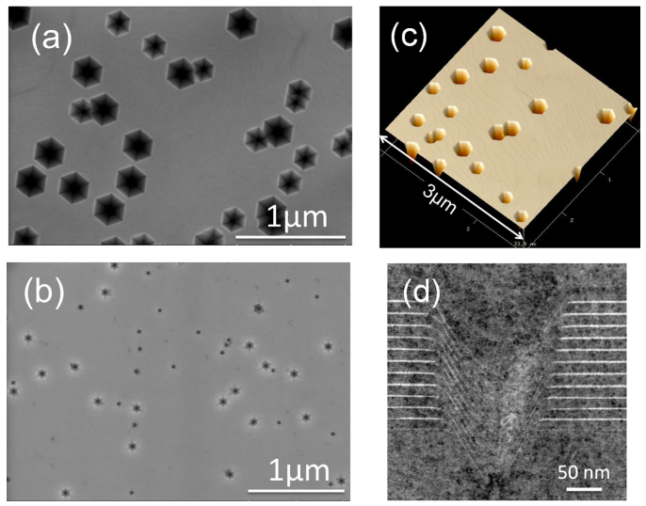
Research Background
V-shaped pits
3D defect: with threading dislocations
Grown in the QWs, filled by the p-GaN layer
Origin: strain and poor surface migration
Density: 1~2*10⁸cm⁻², size: 50-200nm
Li Y, Yun F, Su X, et al. Journal of Applied Physics, 2014, 116(12):253512.
Quan Z J , Liu J L , Fang F ,et al. Optical and quantum electronics, 2016, 48(3):195.1-195.8.

Slide 4
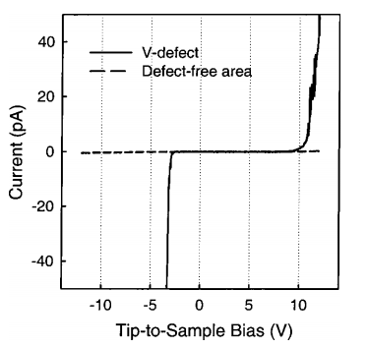
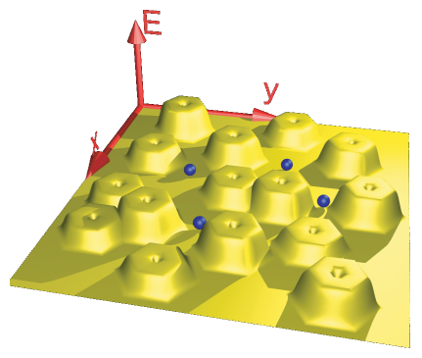
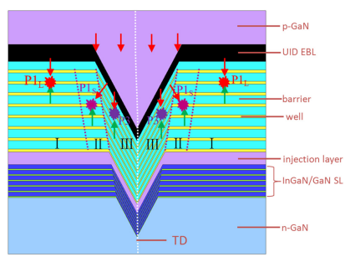
Research Background
Former reports
A leakage current path
Screening dislocations
Improve hole distribution uniformity
Unsettled problems
Is this kind of defects easy to form in theoretical?
What is the interfacial electronic properties of the pits like?
How is the underlying mechanism behind the hole transport beside the pits?
Cao X A , Teetsov J M , D'Evelyn M P , et al. Applied Physics Letters, 2004, 85(1):7-9.
Hangleiter A, Hitzel F, Netzel C, et al. Physical review letters, 2005, 95(12): 127402.
Wu X, Liu J, Jiang F. Journal of Applied Physics, 2015, 118(16): 164504.

Slide 5
Contents
1
Research Background
2
Research Methods
3
Calculation Results
4
Conclusions

Slide 6

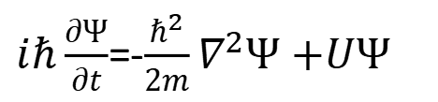
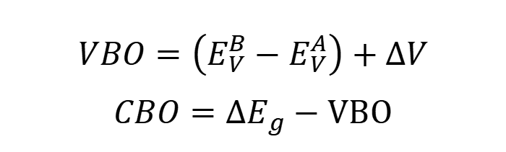
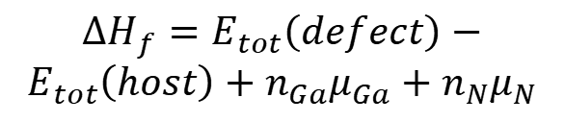
Research Methods
First-principles calculation
Quantum Mechanics Interaction between nuclei and electrons Schrödinger Equation
Density Functional Theory Hohenberg-Kohn Theorem Kohn-Sham Equation
Born-Oppenheimer approximation Hartree-Fock approximation
$iℏ\frac{∂Ψ}{∂t}$=-$\frac{ℏ^{2}}{2m}∇^{2}Ψ$ $+UΨ$
Defect formation
Average potential alignment
$$∆H_{f}=E_{tot}\left(defect\right)−$$
$$E_{tot}\left(host\right)+n_{Ga}μ_{Ga}+n_{N}μ_{N}$$
$$VBO=\left(E_{V}^{B}−E_{V}^{A}\right)+∆V$$
$$CBO=∆E_{g}−VBO$$
$$μ_{Ga}+μ_{N}=E_{tot}\left[GaN\right]$$
$$E_{tot}\left[GaN\right]=μ_{Ga[bulk]}+μ_{N\left[N_{2}\right]+}∆H_{f}[GaN]$$
Zhang, S. B.; Wei, S. H. Physical review letters 2001, 86, 1789-92.
Van de Walle, C. G.; Martin, Physical review. B, Condensed matter 1987, 35, 8154-8165.

Slide 7
Contents
1
Research Background
2
Research Methods
3
Calculation Results
4
Conclusions

Slide 8
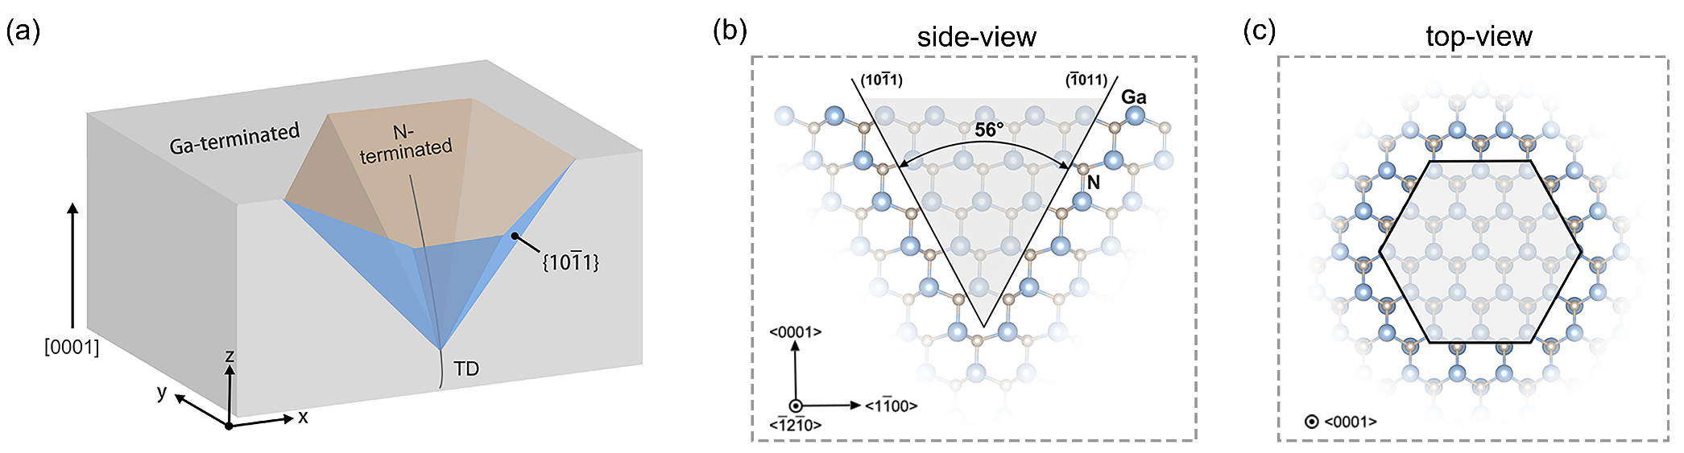
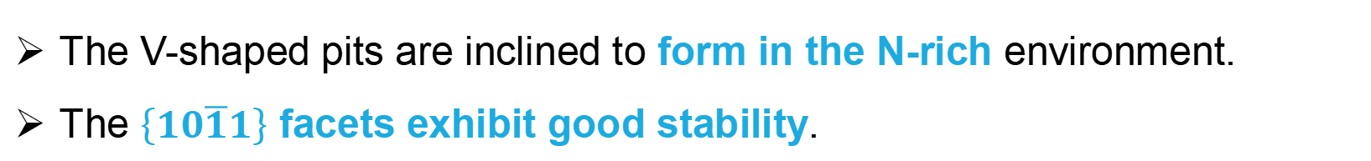
Calculation Results
Result 1
The V-shaped pits are inclined to form in the N-rich environment.
The $\left\{10\overline{1}1\right\}$ facets exhibit good stability.
Geometry of the pits | Formation Energy(eV)
 | N-rich | Ga-rich
V1 | -3.94 | -5.33
V3 | 0.14 | -4.01
V5 | 10.77 | 1.09
Geometry of the pits | The bottom layer | The middle layer | The top layer
V1 | +0.03
V3 | +0.50 | +0.04
V5 | +0.32 | +0.17 | -0.03

Slide 9
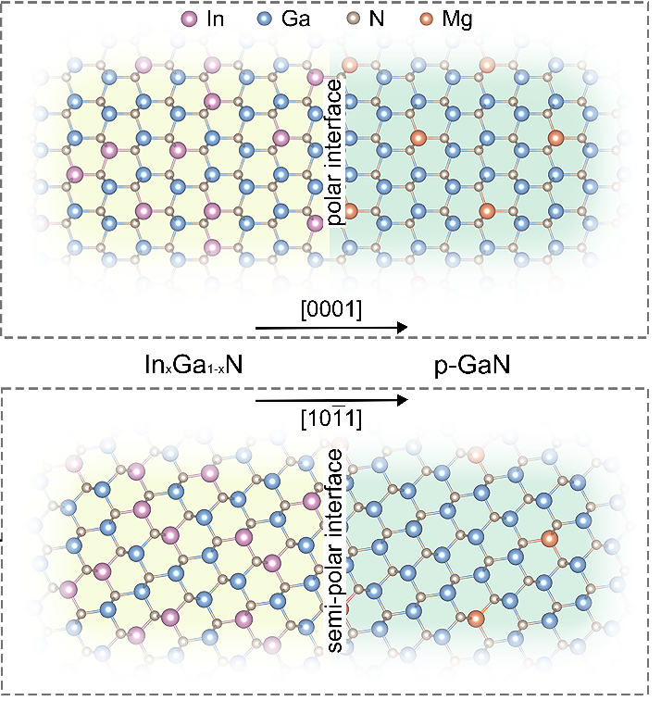
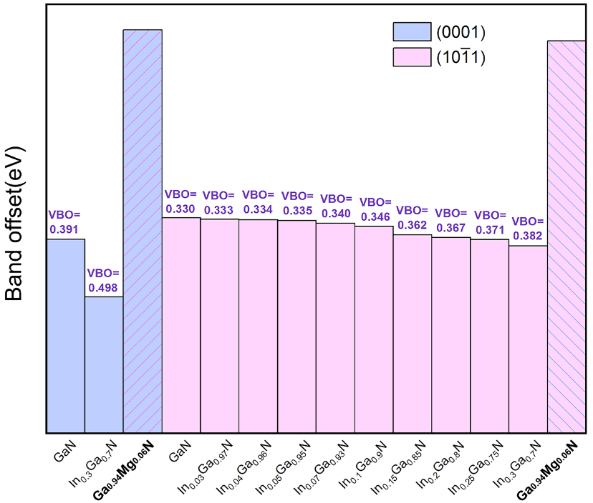
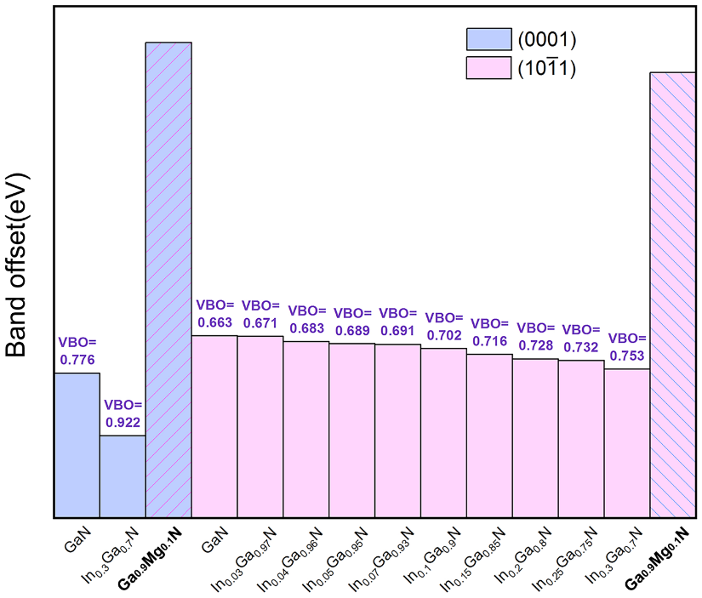
Calculation Results
Result 2
The VBO of the SLs are increasing with the In and Mg composition.
The VBO of semi-polar SLs are smaller than in the polar SLs.
The VBO are positive.

Slide 10
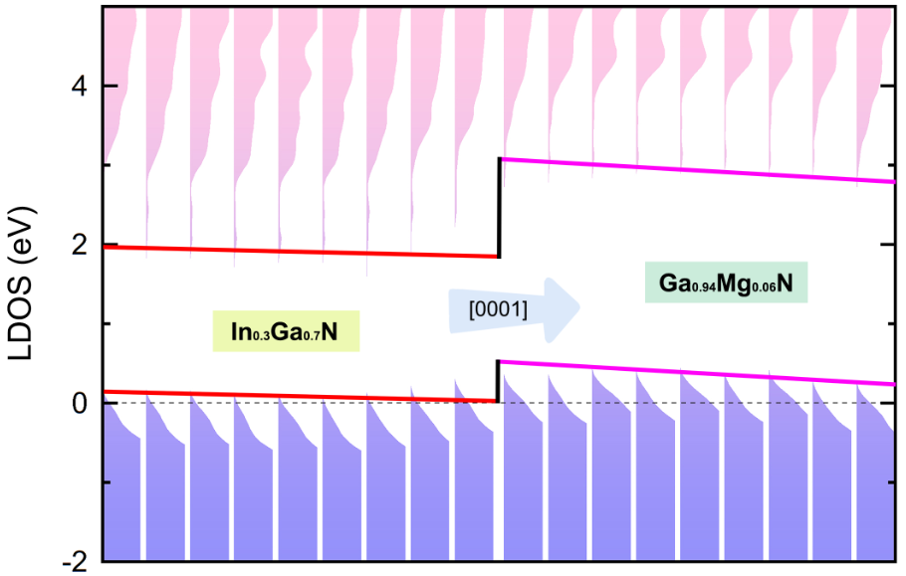
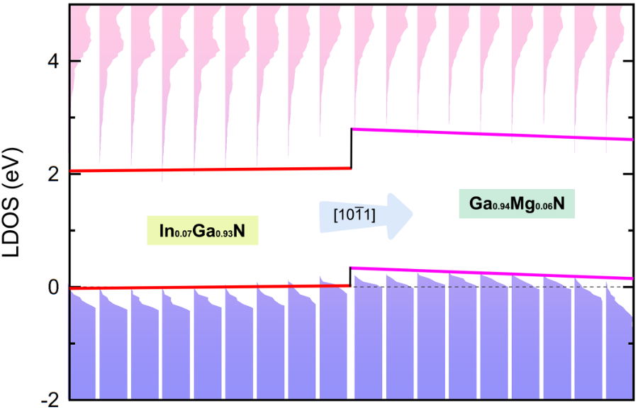
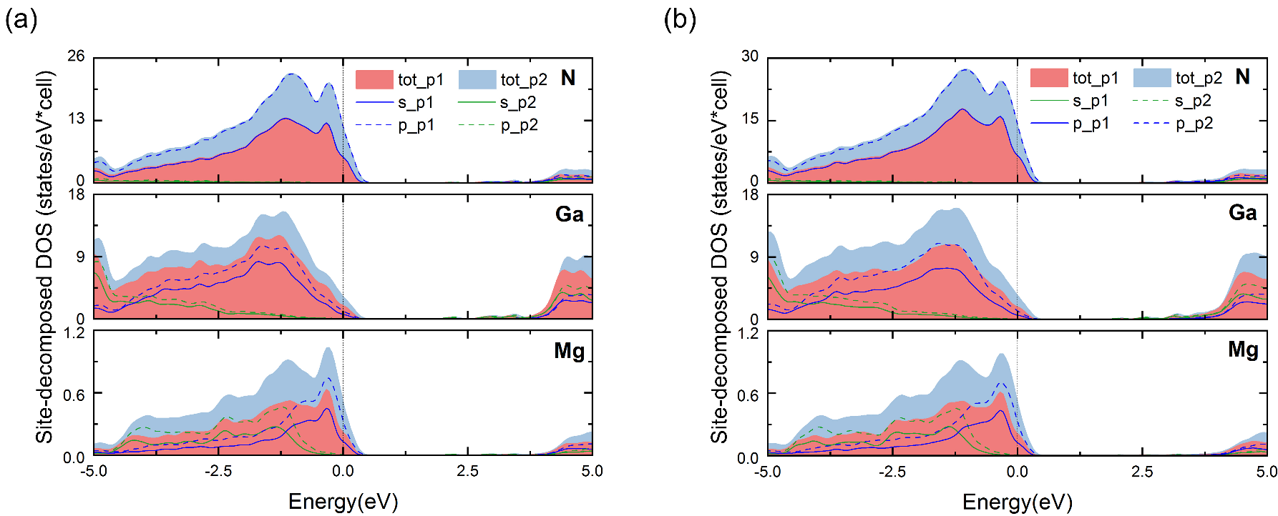
Calculation Results
Result 3
The polarization electronic field in the polar SLs are stronger than in the semi-polar SLs.
The valence band edges in p-GaN layer are higher than in the In_{x}Ga_{1-x}N layer.
The N 2p orbital and Mg 2p orbital have strong hybridization.

Slide 11
Contents
1
Research Background
2
Research Methods
3
Calculation Results
4
Conclusions

Slide 12
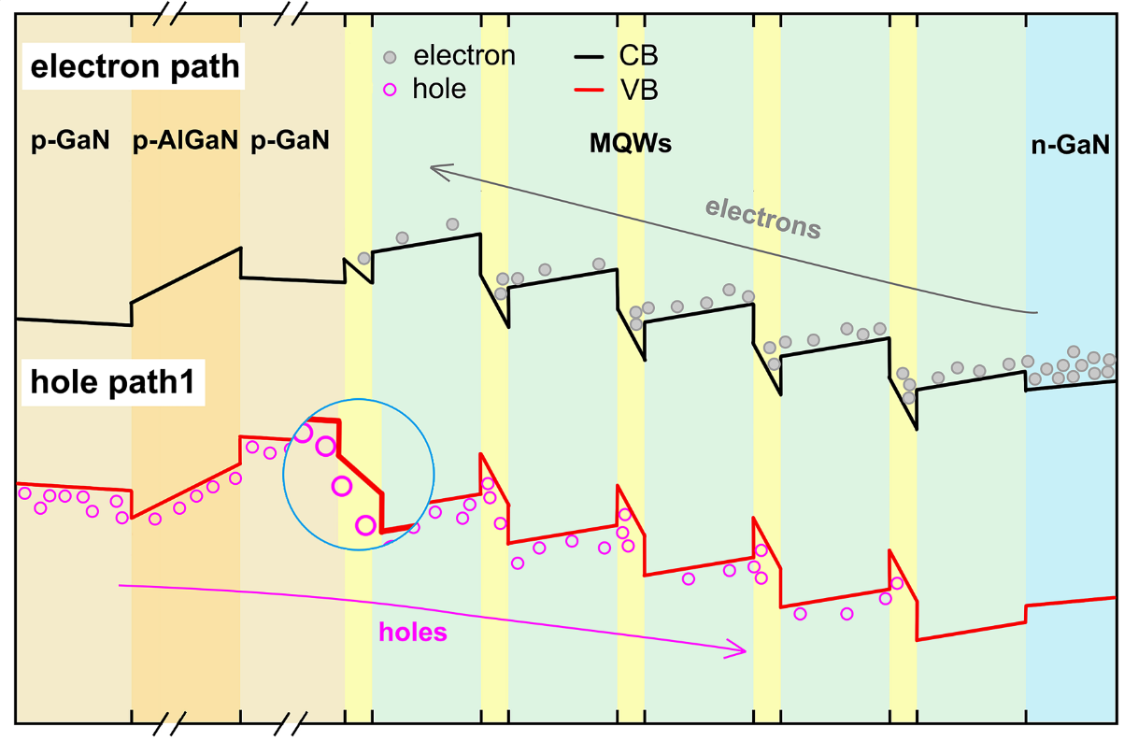
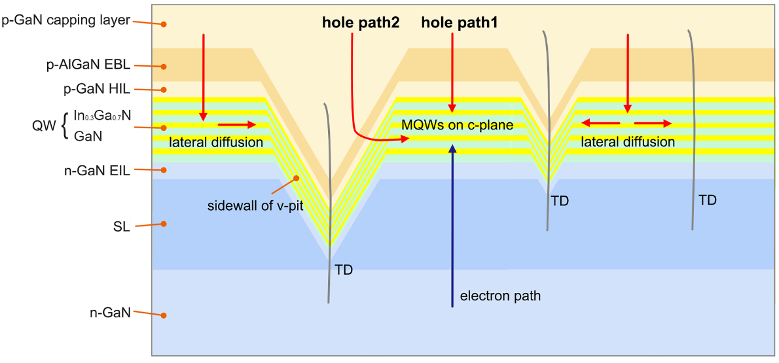
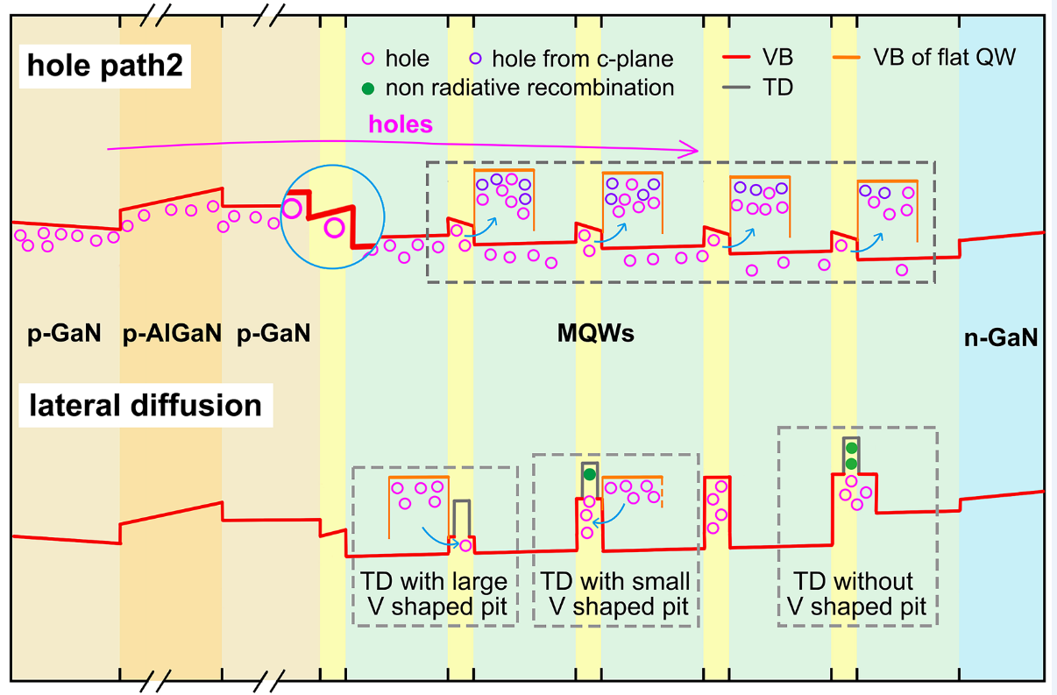
Conclusions
Conclusions
The polarization field and hybridization lead to the band alignment results.
The energy barrier for holes from p-GaN layer inject into the flat QW via the V-shaped pits is smaller than the c-plane.

Slide 13
The 3rd International Conference on Applied Mathematics, Modeling and Computer Simulation (AMMCS 2023)
Thank you for your listening!
Qingqing Feng
Jiangxi Science and Technology Normal University
2023.09.13

