Slide 1
Numerical study on erosion characteristic and structural optimization of ball seat for hydraulic fracturing
Dalian University of Technology
Process Equipment and Control Engineering
Qingxuan WANG
Notes:
Good morning/afternoon everybody. I am very glad to have the opportunity to attend the conference and make a presentation.
My name is Wang Qingxuan, studying in Dalian University of Technology, majoring in Process Equipment and Control Engineering, and my research direction is fluid simulation.
The subject of my presentation is about the numerical study on erosion characteristic in hydraulic fracturing process and to optimize the ball seat structure.

Slide 2

1
Research Background
CONTENTS
2
Research Content
3
Conclusion
Notes:
The main content of my presentation consists of 3 parts: Research background research content conclusion.

Slide 3
Research Background
Part 1
Project introduction
Theory basis
Notes:
The first part is research background. It includes project introduction and theory basis.

Slide 4

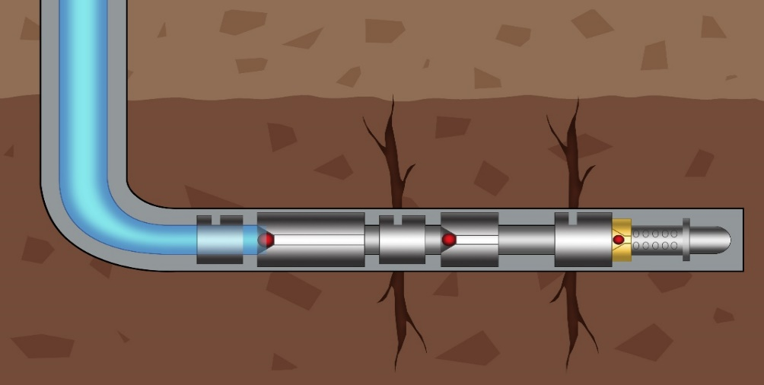
Research Background
Research Background
Project Background
Fig. 1. Schematic diagram for multi-stage fracturing.
The ball seat is eroded and worn to different degrees due to impingement between the tool surface and entrained sand particles in the fracturing fluid. Ball seat is the research object.
Notes:
Fig1 is the multistage fracturing diagram. The main process is fracturing fluid carrying sand particles flows into pipes and creates a pressure that is greater than the rated pressure in the ball seat system. Then, fracturing fluid spray out of the hydraulic pipe, and fracturing process is realized. In this process, the ball seat plays an essential role in controlling the flowing of fracturing fluid. However, because of structure and the two-phase fluid, the ball seat becomes a vulnerable part. It is eroded and worn to different degrees due to impingement between the surface and sand particles. Once ball seat cannot seal the seat, it will degrade fracturing performance or even cause the failure of fracturing process. So the ball seat is the research object.

Slide 5
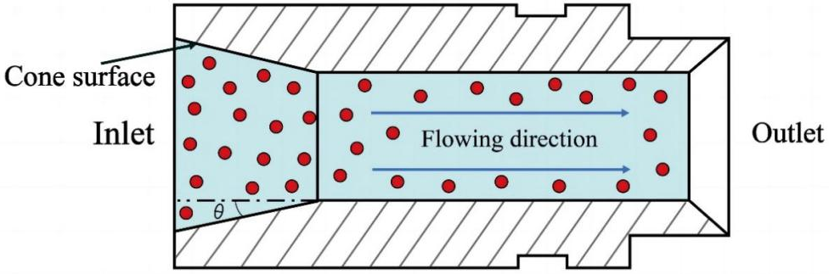
Research Background
Research Background
Project Background
Fig. 2. Schematic diagram for ball seat.
The junction where the cone surface and the small cylinder meet is the part that suffers more serious erosion wear than other parts, which is also the focus of the investigation.
Notes:
Let’s enlarge the ball seat structure. It is clear to see this picture. Ball seat is a conical structure with an inlet and outlet. The fracturing fluid flows into the inlet and flows out of the outlet. Due to the structural features, the junction where the cone surface and the small cylinder meet is the part that suffers more serious erosion wear than other parts. Because of this, it is the focus of the investigation.

Slide 6
Research Background
Research Background
Exiting Problems
However, most studies focus on the analysis of working conditions, material selection and improvement of simple cone angles.
2. Only a few of them concentrate on improving the cone styles of the ball seat.
3. The morphology change caused by long-term erosion is lacking in most research.
1. Structures are still not perfect.
Notes:
Focusing on this problem, I did some literature research. I found the following 3 problems. The first one is only a few of research concentrate on improving the cone styles of the ball seat. Although there are some studies that have been done on ball seat structures, they are still not perfect. This is the second one. Besides, the morphology change caused by long-term erosion is lacking in most research. Therefore, it is necessary to study the cone structure of the ball seat in more depth.

Slide 7
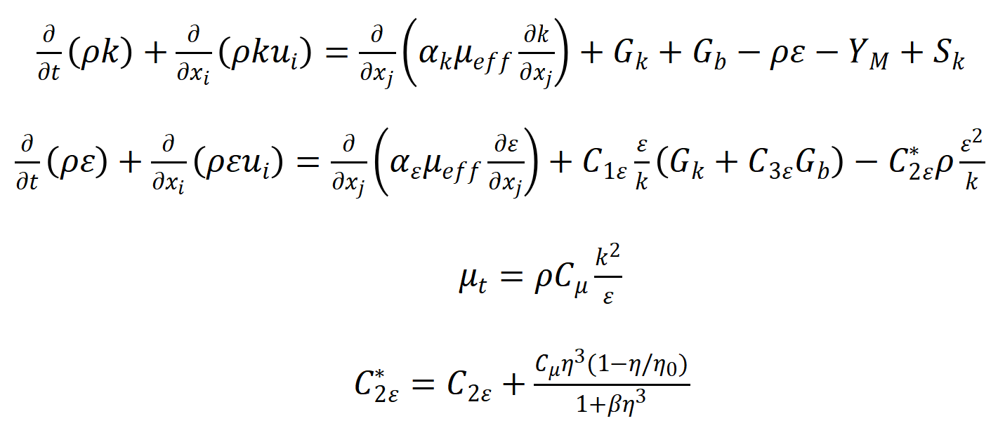
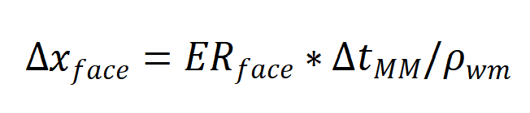
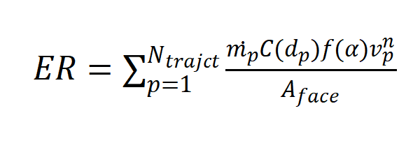
Research Background
Research Background
Fracturing principle
Turbulence model
RNG k-ε equation
Theory Basis
Erosion model
Dynamic mesh theory
Generic Erosion Model
Notes:
To conduct my study, some theories should be cleared. I list 4 theories here, fracturing principle, turbulence model, erosion model and dynamic mesh theory. After understanding the fracturing process, I chose the RNG k-ε equation and the Generic Erosion Model. For dynamic mesh theory, it is an innovation point in my research. The specific erosion rate of wall surface within the physical time size delta t divided by wall material density represents the deformation of an individual surface unit. And every mesh position in software will be updated by this formula. By setting dynamic mesh, the deformation of ball seat will be predicted accurately.

Slide 8
Research Content
Part 2
Numerical procedure
Results analysis
Notes:
In the next part, I will introduce the research content. It includes numerical procedure and results analysis.

Slide 9
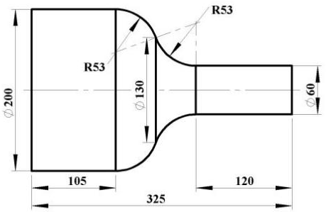
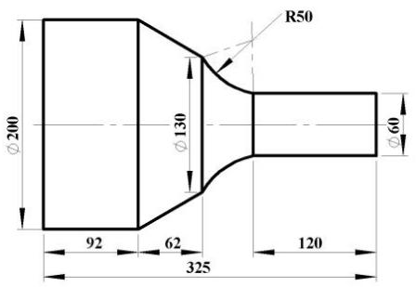
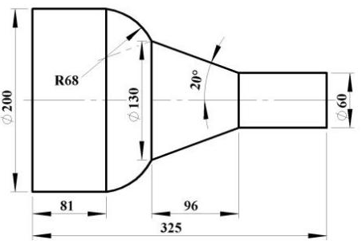
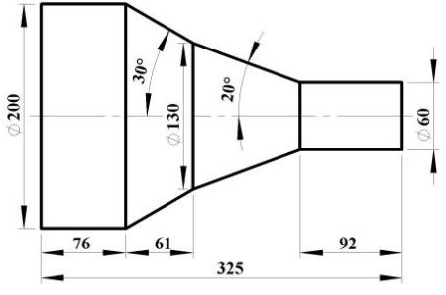
Research content
Geometric Models
(a)
(b)
B
B
A
A
(c)
(d)
B
A
B
A
Fig. 3. Dimensions of four models of ball seat: (a) convex + concave curve, (b) cone + concave curve, (c) convex curve + cone, (d) double cone. (The units in the figure not labeled are in mm.)
Notes:
I referred to the design ideas of previous research, the segmented design can improve the erosion performance better. And then I combined the structural ideas of two-segments and convex、concave surfaces, and designed four new ball seat structure models into SOLIDWORKS. These four models are the different combination of cone surface、convex surface and concave surface. They theoretically have better erosion resistance than traditional ball seat structures.

Slide 10
Research content
Boundary Conditions
Table 1. Boundary conditions and parameters.
Boundary conditions | Parameter values
Construction displacement, m³/min | 6
Inlet velocity, m/s | 18.19
Sand flow rate, kg/s | 13
Hydraulic diameter, m | 2.8
Turbulence intensity, % | 0.028
Outlet pressure, MPa | 50
Entrance boundary condition:
Velocity-inlet
Export boundary conditions:
Outlet-pressure
Wall boundary conditions:
Reflection (normal and tangential coefficient of restitution)
Notes:
The Table 1 shows some boundary condition parameters. They are surveyed according to the actual working condition. In the simulation, the entrance boundary condition is velocity-inlet, the export boundary condition is outlet-pressure. The wall boundary condition is defined by the normal and tangential coefficient of restitution functions to illustrate the reflection boundary process.

Slide 11
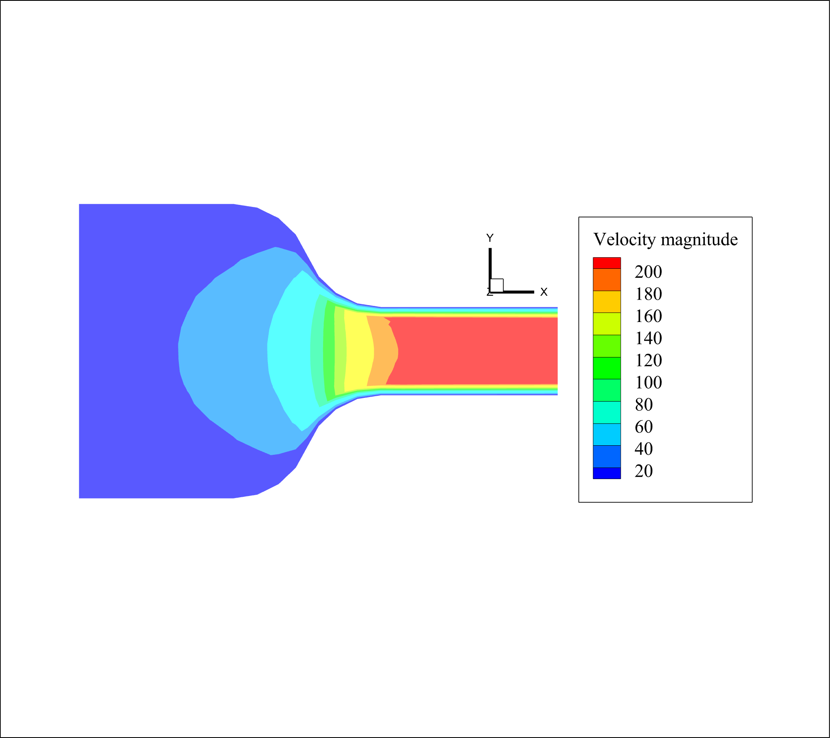
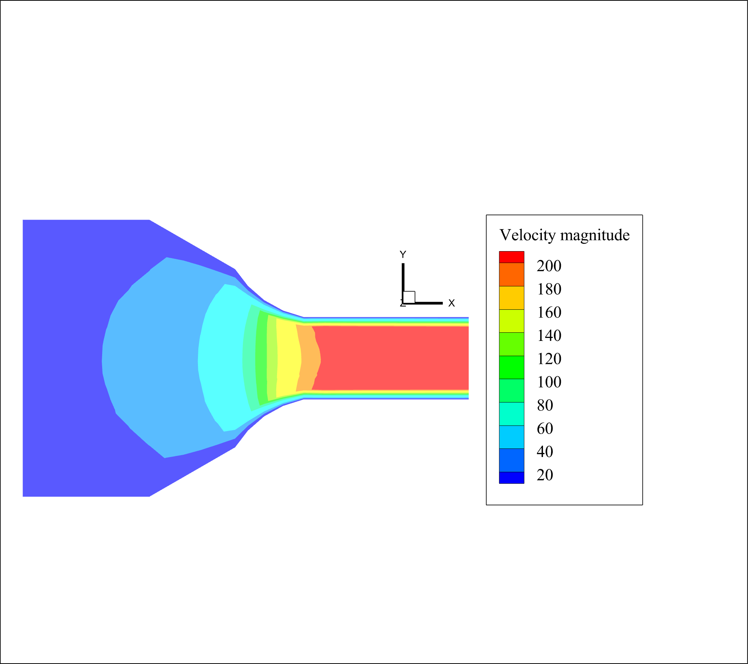
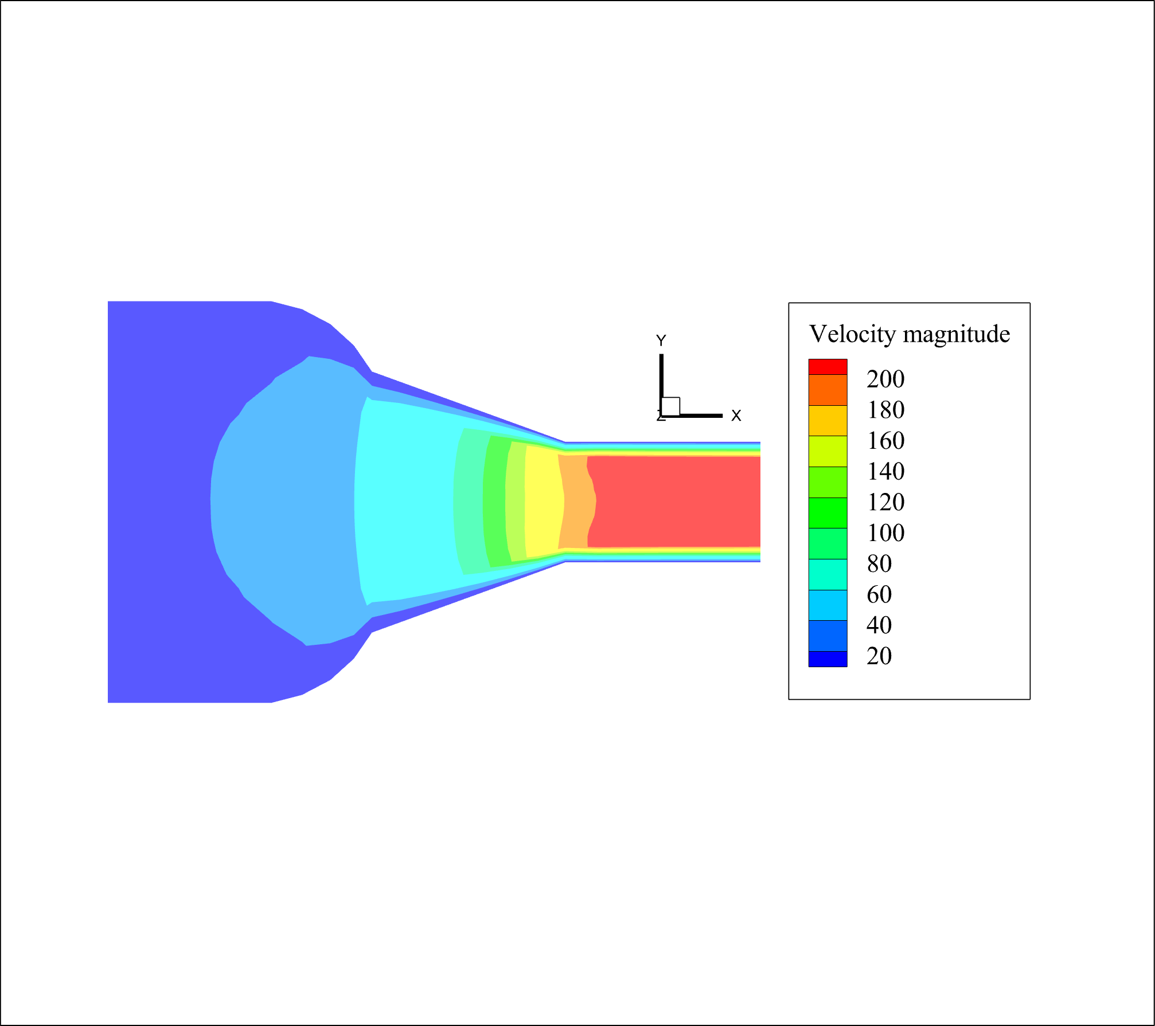
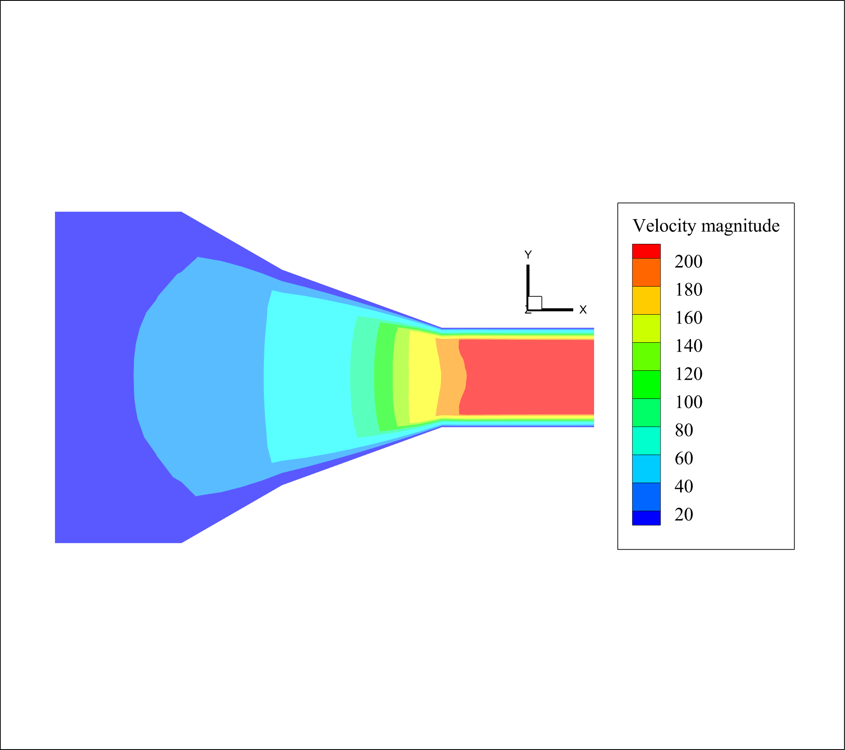
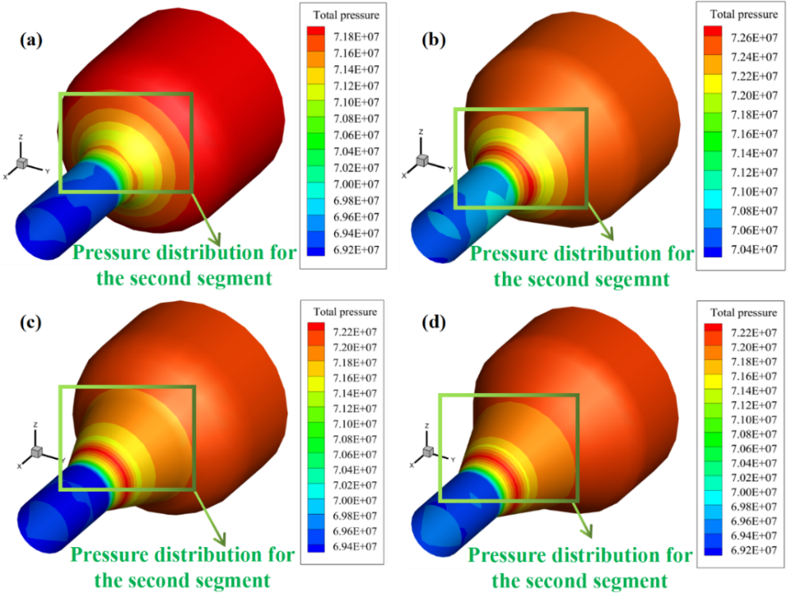
Research content
Mechanism Analysis
(a)
(b)
Fig. 4. Velocity magnitude distribution of plane Z = 0 inside the four different structures:
convex + concave curve,
cone + concave curve,
(c) convex curve + cone,
(d) double cone.
(c)
(d)
Fig. 5. Total pressure distribution:
(a) convex + concave curve,
(b) cone + concave curve,
(c) convex curve + cone,
(d) double cone.
Notes:
After 1200 seconds of running an ANSYS Fluent simulation, I got the velocity and pressure contours of 4 structures. Figure 4 shows the velocity contour inside the structure and figure 5 shows the total pressure contour on the wall surface. From figure 4, the junction between the small cylinder and the second segment of structure has the largest velocity gradient. From figure 5, the total pressure value for every structure is significant in the center of the green box. And the convex and concave curve surface structure has the lowest total pressure in the green box. It illustrates that the convex and concave structure is optimal for protecting the wall surface.

Slide 12
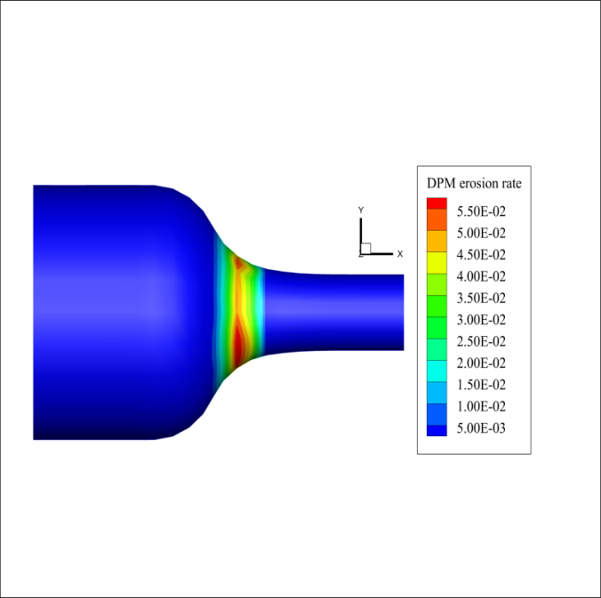
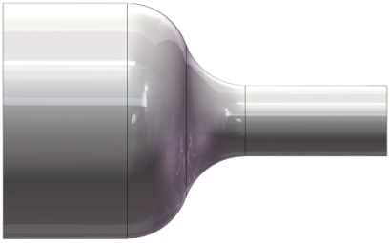
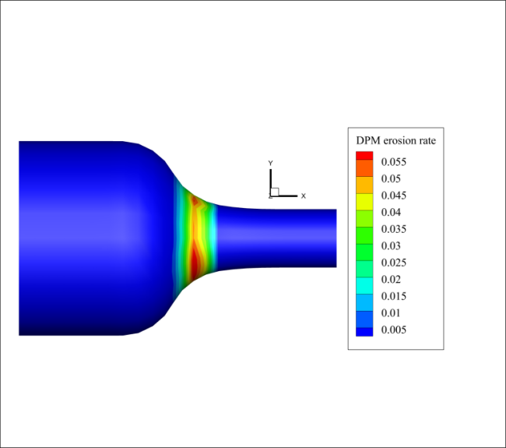
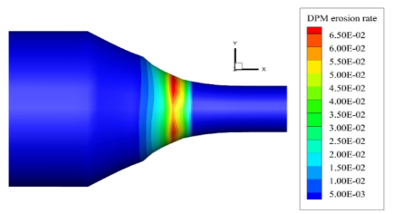
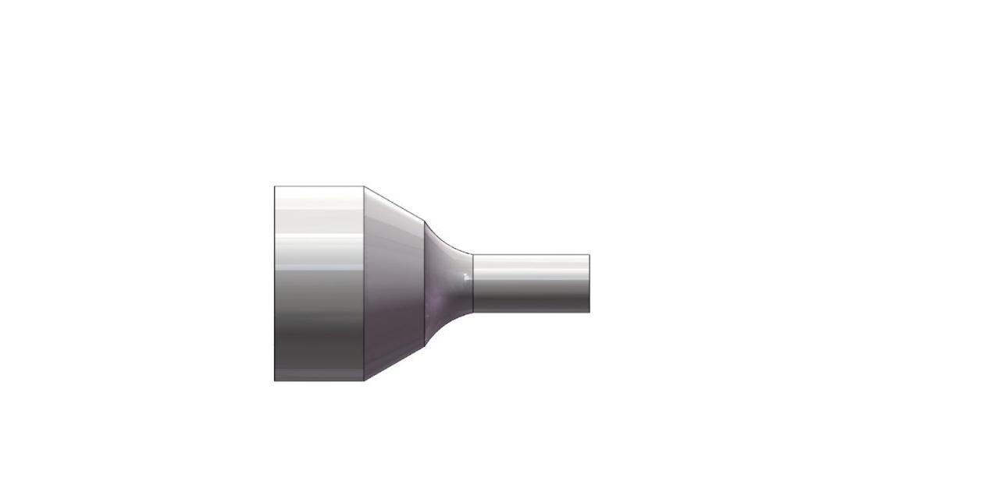
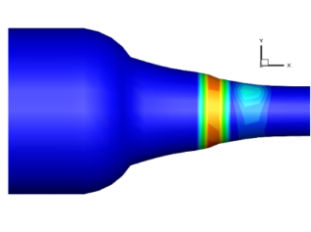
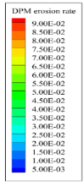
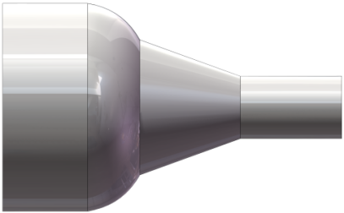
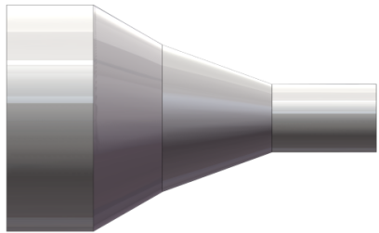
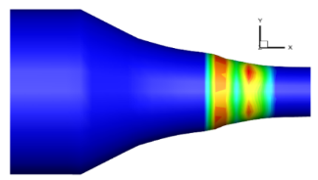

Research content
Erosion Rate Analysis
(a)
(a₁)
The morphology change before and after erosion wear is displayed and erosion rate distribution is measured in different positions of structures.
(b)
(b₁)
(c)
(c₁)
Fig. 6. Different structures before erosion: (a) convex + concave curve, (b) cone + concave curve, (c) convex curve + cone, (d) double cone. Erosion rate contours with morphology change after 1200 s erosion: (a₁) convex + concave curve, (b₁) cone + concave curve, (c₁) convex curve + cone, (d₁) double cone.
(d)
(d₁)
Notes:
Next, I analyzed the erosion rate of each structure. I got the erosion rate contours of every structure. The contours figure after erosion is a1,b1,c1,d1. From these erosion contours, the place of the high erosion rate is mainly concentrated in the red circles. Besides, the erosion rate for every structure reaches its maximum at the center of red circles and gradually decreases to both sides, which can be proved to be true by the simulation results of the previous study. With using of the dynamic mesh theory, the morphology change can also be represented after simulation. Before and after erosion, the 4 models in the right hand are deformed in different degrees compared with the left hand. This change can be illustrated intuitively by using this technique.

Slide 13
Research content
Erosion Rate Analysis
(a)
(b)
Fig. 7. Maximum and average erosion rate of different structures.
Fig. 8. The maximum deformation values of four structures.
Notes:
If you cannot see the change very clearly, the maximum deformation values are exported and illustrated by the bar chart below in the figure 8. By contrast, the convex and concave curve model has the smallest deformation and the double cone has the largest deformation. This finding can also be reflected by the maximum and average erosion rate of different structures in the figure 7 above. Whether it is the average or the maximum, the convex and concave model has the smallest erosion rate among 4 models. As a result, the convex and concave structure has the best performance.

Slide 14
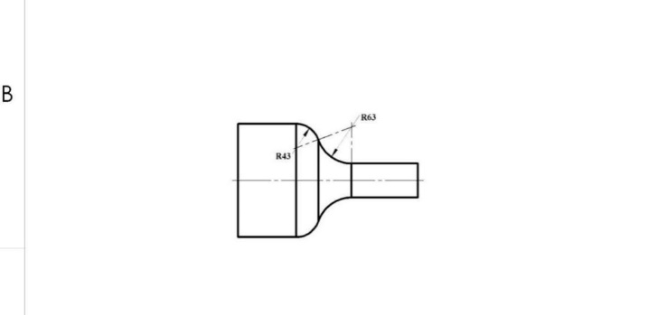
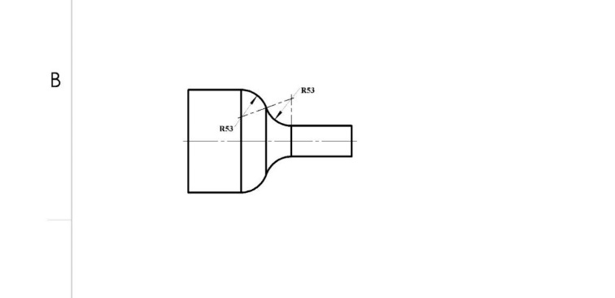
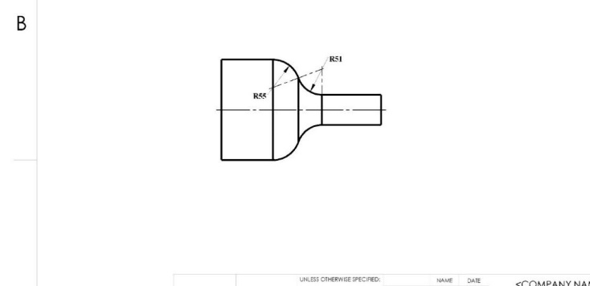

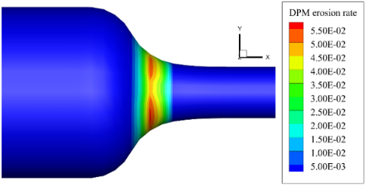
Research content
Curvature Analysis
(a)
(b)
(a)
(b)
(c)
The numerical analysis on the convex and concave surface with different curvature is done.
(c)
(d)
Fig. 9. (a) Maximum and average erosion rate of structures with different curvature radii of convex curve.(b) Maximum erosion wear of structures with different curvature radii of convex curve.(c) The convex and concave curve surface structure with the 49 mm convex curvature and 57 mm concave curvature. (d) Erosion rate contours of this structure.
Notes:
Based on this best structure, I then did the curvature analysis work so that my model could be exactly used in production. In this study, 13 sets of curvature parameters of convex and concave structures are established. Using the same method to simulate these 13 models, I got their maximum erosion rates as this black line shows and the average erosion rate as the red line shows. At the same time, the maximum deformation values of these models are also exported. It is clear to see the structure with the 49 mm convex curvature and 57 mm concave curvature has the best erosion resistance because it has the lowest maximum erosion rate, relatively low average erosion rate and most minor erosion wear among these models.

Slide 15
Part 3
Conclusion
Notes:
The last part is my research conclusion.

Slide 16
Conclusion
Conclusion
1. The Fluent theoretical models are established to analyse different ball seat structures in the actual working conditions.
2. The difference in erosion behaviour is caused by the different pressure distribution of the ball seat surface.
3. The convex and concave curve surface structure with 49 mm convex curvature and 57 mm concave curvature has the lowest maximum erosion rate and relatively low average erosion rate, which leads to its best performance for resisting erosion wear.
Notes:
Through the research of ball seat structure,

Slide 17
Reference
[1] Schultz R, Skoumal RJ, Brudzinski MR, Eaton D, Baptie B, Ellsworth W. Hydraulic fracturing‐induced seismicity. Reviews of Geophysics. 2020;58(3).
[2] Hossain MM, Rahman MK. Numerical simulation of complex fracture growth during tight reservoir stimulation by hydraulic fracturing. Journal of Petroleum Science and Engineering. 2008;60(2):86-104.
[3] Rutqvist J, Rinaldi AP, Cappa F, Moridis GJ. Modeling of fault reactivation and induced seismicity during hydraulic fracturing of shale-gas reservoirs. Journal of Petroleum Science and Engineering. 2013;107:31-44.
[4] Barati R, Liang JT. A review of fracturing fluid systems used for hydraulic fracturing of oil and gas wells. Journal of Applied Polymer Science. 2014;131(16).
[5] Nandlal K, Weijermars R. Drained rock volume around hydraulic fractures in porous media: planar fractures versus fractal networks. Petroleum Science. 2019;16(5):1064-85.
[6] Miao WJ, Zhao LQ. Development status and prospect of staged fracturing technology in horizontal wells. Electronic Journal of Geotechnical Engineering. 2017;22:5107-18.
[7] Anastasiou E, Lorentz KO, Stein GJ, Mitchell PD. Prehistoric schistosomiasis parasite found in the Middle East. The Lancet Infectious Diseases. 2014;14(7):553-4.
[8] Mengoni M, Mandolini M, Matteucci M, Germani M. A scalable “design for costing” platform: a practical case in ball valves industry. Procedia CIRP. 2016;50:311-7.
[9] Zheng C, Liu Y, Chen C, Qin J, Zhang S. Finite element analysis on the dynamic erosion process using multiple-particle impact model. Powder Technology. 2017;315:163-70.
[10] Zheng C, Liu Y, Wang H, Zhu H, Ji R, Liu Z, et al. Research on the effect of gas nitriding treatment on the wear resistance of ball seat used in multistage fracturing. Materials & Design. 2015;70:45-52.
[11] Forder A, Thew M, Harrison DJW. A numerical investigation of solid particle erosion experienced within oilfield control valves. 1998;216(2):184-93.
[12] Zoveidavianpoor M, Gharibi A. Application of polymers for coating of proppant in hydraulic fracturing of subterraneous formations: a comprehensive review. Journal of Natural Gas Science and Engineering. 2015;24:197-209.
[13] Rosine RS, Blanco I, Bailey M, editors. Comparison of computational fluid dynamics of erosion in coiled tubing to field and test data. SPE/ICoTA Coiled Tubing and Well Intervention Conference and Exhibition; 2008: OnePetro.
[14] Bagherifard S, Fernández Pariente I, Guagliano M. Failure analysis of a large ball valve for pipe-lines. Engineering Failure Analysis. 2013;32:167-77.
[15] Zhou XL, Guo YB, Xie QJ, Wang DG, Yoon HC. Numerical study on erosion behavior of sliding sleeve ball seat for hydraulic fracturing based on experimental data. Petroleum Science. 2023;20(1):515-25.
[16] Carrejo N, Wibowo H, Espinoza OR, Gaudette SL, editors. Smart-engineered ball seat system to optimize flow area in multi-zone fracturing treatments. SPE Unconventional Resources Conference Canada; 2013: OnePetro.
[17] Zheng C, Liu Y, Wang H, Zhu H, Liu Z, Cai B, et al. Numerical study on improving the erosion life of ball seat for oil and gas reservoir fracturing. Engineering Failure Analysis. 2016;60:188-98.
[18] Rasteh A, Farokhipour A, Rasoulian M, Mansoori Z, Saffar-Avval M, Ahmadi G, et al., editors. A numerical study of sand particle erosion in a series of ball seats in gas-particle two-phase flow. Fluids Engineering Division Summer Meeting; 2019: American Society of Mechanical Engineers.
[19] Ding K, Li JM, Yang WX, Hu J, Zeng W. Numerical simulation of erosion wear of liquid-solid two-phase flow in sliding sleeve of horizontal well. Advanced Materials Research. 2014;988:483-8.
[20] Ding K, Yin H, Wan B, Cheng H, Xiang L, Li J. Analysis of particle size to erosion wear of sliding sleeve ball seat based on fluent software. AIP Conference Proceedings. 2017;1829(1).
Part 3

Slide 18
Thanks for the opportunity provided by
the 3rd International Conference on Applied Mathematics, Modeling and Computer Simulation
Thank you for listening!
Welcome your valuable comments!
Notes:
In the end, I’m very grateful to this conference for providing me with this valuable opportunity.
Thank you for your listening and welcome your valuable comments.

