Slide 1


The 3rd International Conference on Applied Mathematics,
Modeling and Computer Simulation (AMMCS 2023)
Influence of different substrates on the polarization effect of InGaN-based LEDs
Li Liu，Qingqing Feng，Wenxiao Wu，Chao Zeng，Zhihua Xiong*
Key Laboratory for Optoelectronics and Communication of Jiangxi Province
https://jxgd.jxstnu.edu.cn

Slide 2
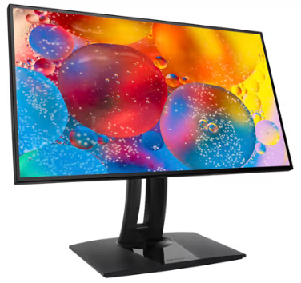
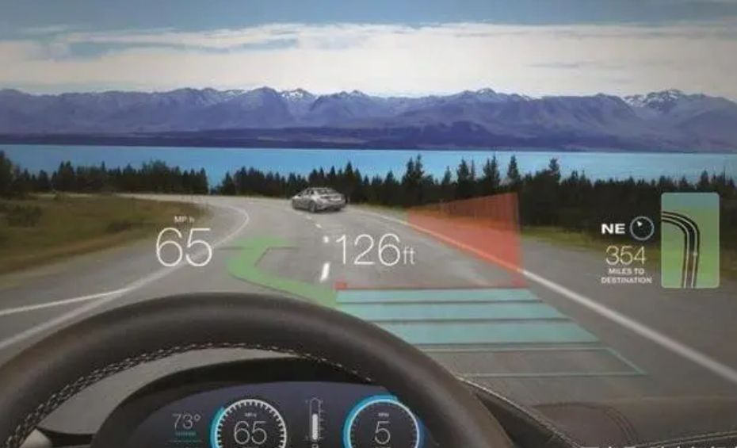
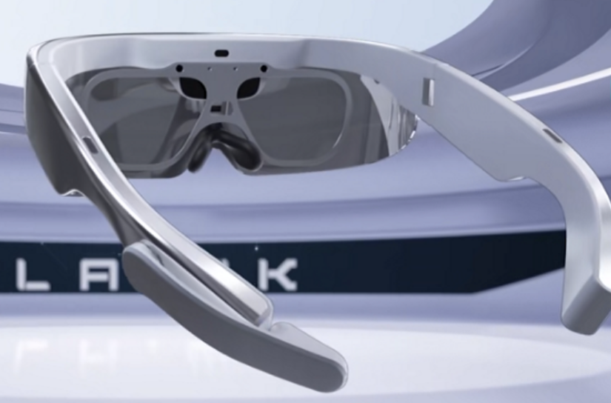
Research background
InGaN-based LEDs ( Green /Red / Blue )
AR/VR
MAC Large Screen Display
Garmin HUD
EQE (external quantum efficiency)
Blue 80%
Green 40%
Red < 2.5%
The EQE of InGaN-based yellow LEDs/Substrate
13.4% /semi-polar GaN
18.9% /c-faced sapphire
33.7% /Si
This is a challenge:
The efficiency of long wavelength LED decreases
Quantum confinement Stark effect (QCSE)
induced by lattice mismatch

Slide 3
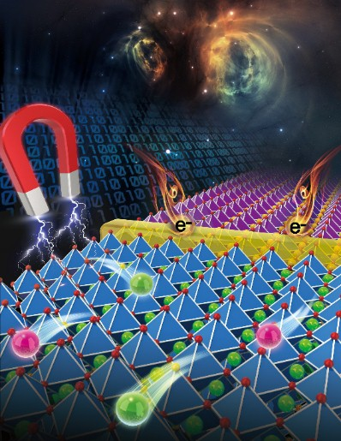
Theory background
LEDs diagram
Lattice mismatch
between substrate and GaN
The strain state of GaN
Compressive: Sappphire and SiC Tensile: Si
“The interface is the device”
---- Prof. Herbert Kroemer
Polarization field induced QCSE decrease
The compression strain of InGaN well layer
decrease

Slide 4
Computational process
Calculate model
Calculate method
Density functional theory (DFT)
based on Ab into calculation
GaN
GaN
InGaN
$$E\left[ρ\right]=T_{s}\left[ρ\right]+V_{ne}\left[ρ\right]+J\left[ρ\right]+E_{xc}\left[ρ\right]$$
Electron kinetic energy
The potential energy of electrons and nuclei (electrons)
The exchange-correlation energy among electrons
Generalized Gradient Approximation (GGA)
Perdew-Berke-Ernzerhof (PBE)
GaN/In_{0.3}Ga_{0.7}N/GaN supercell

Slide 5
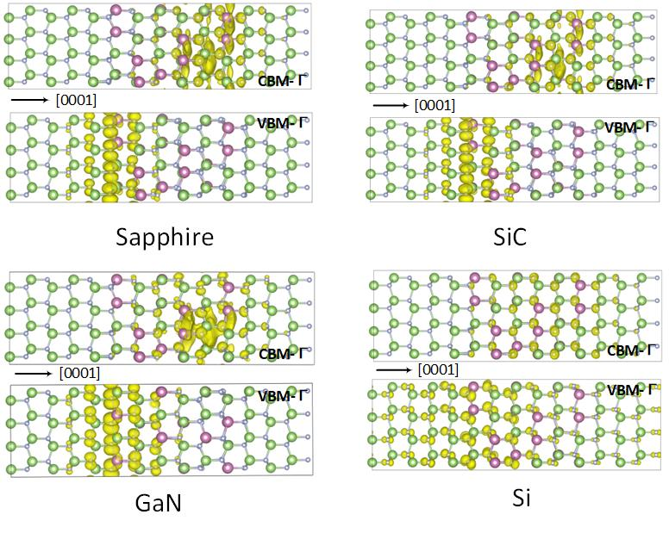
Calculation result
VBO reduction facilitates hole injection
into InGaN/GaN QWs
Band decomposed charge density
belonging to CBM/VBM at Γ point

Slide 6
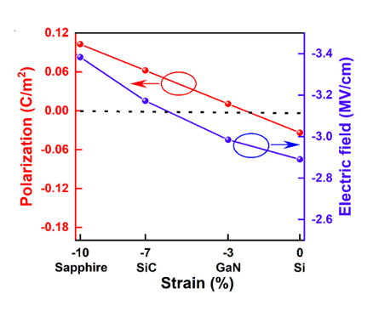
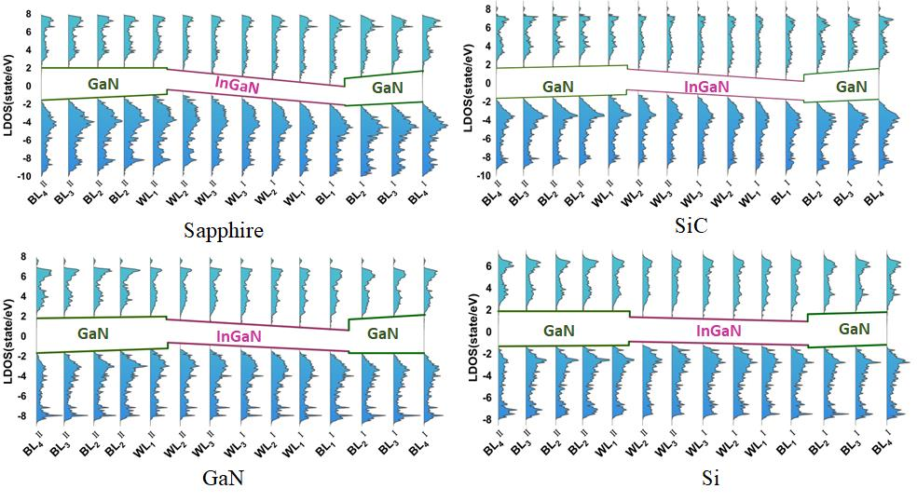
Calculation result
The internal piezoelectric field of InGaN layer decreases with decreasing compressive strain.
The piezoelectric polarization results in the separation of positive and negative charge centers.

Slide 7
Calculation result
The compressive strain of InGaN layer decrease
The piezoelectric polarization decrease
The polarized bound charge decrease
The recombination of electrons and holes in QWs is enhanced

Slide 8
Thank you for listening!
The 3rd International Conference on Applied Mathematics,
Modeling and Computer Simulation (AMMCS 2023)
Reporter: Liuli
Influence of different substrates on the polarization effect of InGaN-based LEDs

